Slide 1
Ch10. Auto-encoders
KH Wong

Slide 2
Two types of autoencoders
Part1 : Vanilla (traditional or classical) Autoencoder
or simply called Autoencoder
Part 2: Variational Autoencoder

Slide 3
Part 1: Overview of Vanilla (traditional/classical) Autoencoder
Introduction
Theory
Architecture
Application
Examples

Slide 4
Introduction
What is auto-decoder?
An unsupervised method
Application
For noise removal
Dimensional reduction
Method
Use noise-free ground truth data (e.g. MNIST)+ self generative noise to train the network
The final network can remove noise of input corrupted by noise (e.g. hand written characters), the output will be similar to the ground truth data

Slide 5
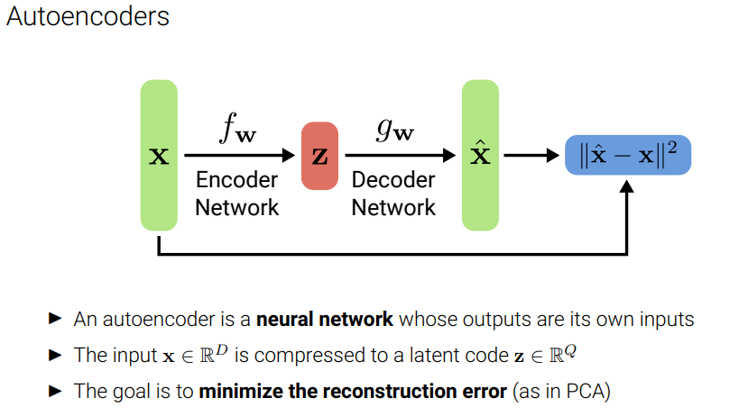

Slide 6
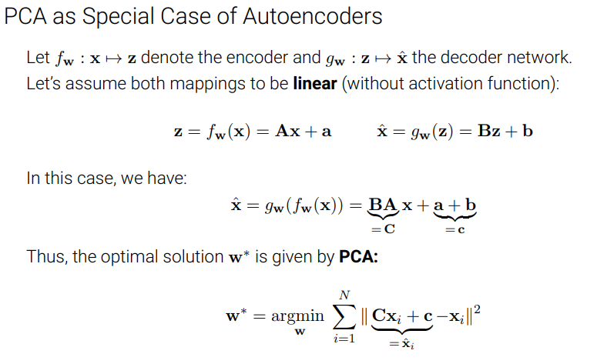

Slide 7
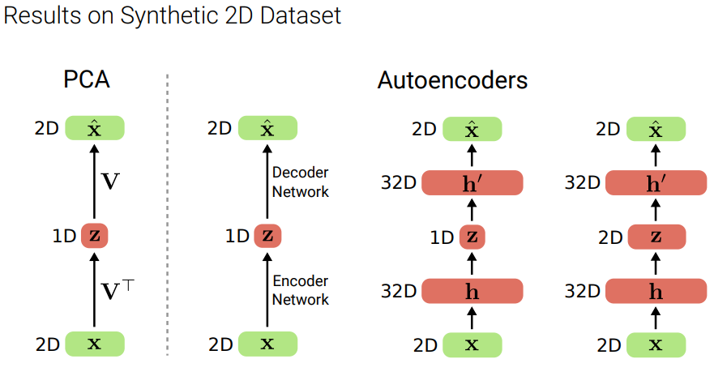

Slide 8
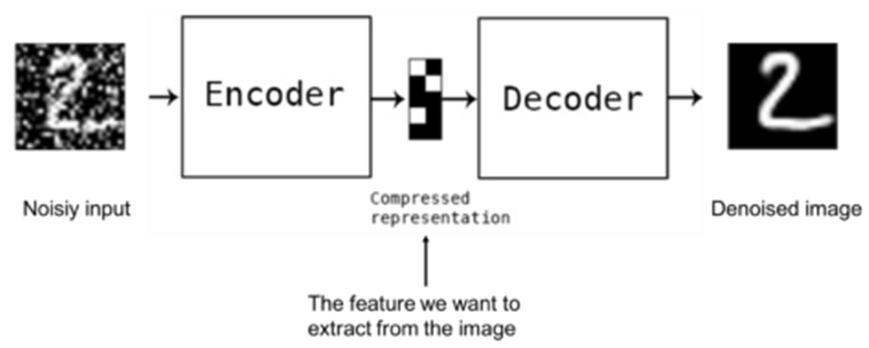
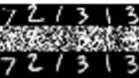
Noise removal
https://www.slideshare.net/billlangjun/simple-introduction-to-autoencoder
Result:
plt.title('Original images: top rows,' 'Corrupted Input: middle rows, ' 'Denoised Input: third rows')

Slide 9
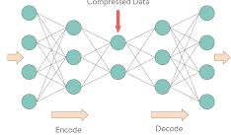
Auto encoder Structure
De-noised
Output
x‘
An autoencoder is a feedforward neural network that learns to predict the input (corrupted by noise) itself in the output.
The input-to-hidden part corresponds to an encoder
The hidden-to-output part corresponds to a decoder.
Input and output are of the same dimension and size.
Noisy
Input
x
Z (code)
x
x‘
encoder
decoder
Neural network after training
https://towardsdatascience.com/deep-autoencoders-using-tensorflow-c68f075fd1a3

Slide 10
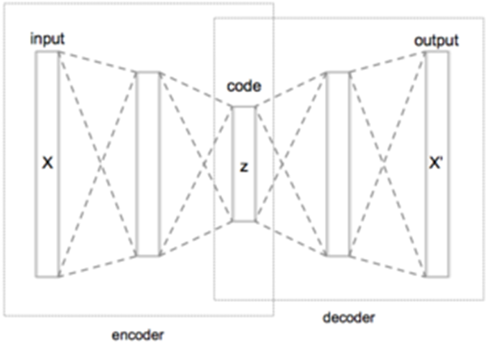
Theory (W=weight, b=bias)
Input code output
X W
b
σ
Z W’
b’
σ’ x’
Autoencoders are trained to minimize reconstruction errors (such as squared errors), often referred to as the "loss (L)":
By combining (*) and (**)
Encoder decoder
Notes:
\subsection{Theory}
%%eeeeeeeeeeeeeeeeeeeeeeeeeeeeeeeeeeeeeeee
$x \rightarrow F \rightarrow x'$\\
$z=\sigma (Wx+b)------(*)$\\
$x'=\sigma'(W'z+b')---(**)$\\
Autoencoders are trained to minimize reconstruction errors (such as squared errors), often referred to as the "loss (L)":\\
By combining (*) and (**)\\
$Loss=L(x,x')=\| x-x' \|^2$\\
$\| x-\sigma' ( W' \sigma (W x+b)+b' \|^2$\\

Slide 11
Exercise 1
How many input layers, hidden layers, output layers in the figure shown?
How many neurons in these layers?
What is the relation between the number of input and output neurons?
Input
Output

Slide 12
Answer : Exercise 1
Input
Output
How many input layers, hidden layers, output layers in the figure shown?
Answer:1 input, 3 hidden,1 output layers
How many neurons in these layers?
Answer: input(4), hidden(3,2,3), output (4)
What is the relation between the number of input and output neurons?
Answer: same

Slide 13
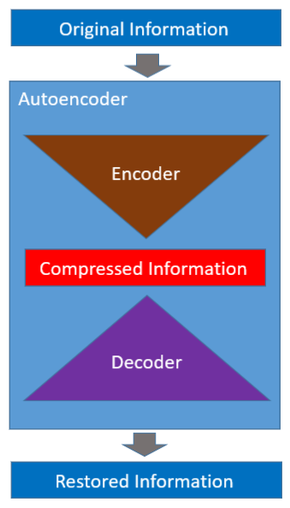
Architecture
Encoder and decoder
Training can use typical backpropagation methods
https://towardsdatascience.com/how-to-reduce-image-noises-by-autoencoder-65d5e6de543

Slide 14
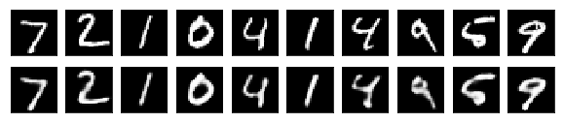
Training
Apply clean MNIST data set + added noise to be used as input,
Use clean MNIST data set as output
Train the autoencoder using backpropagation
Added noise
Clean MNIST samples
+
same
Autoencoder training by backpropagation
Clean MINST
samples

Slide 15
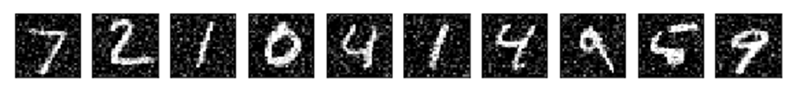
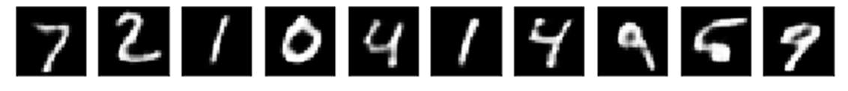
Recall
After training, autoencoders can be used to remove noise
Noisy
Input
Trained
autoencoder
De-noised
Output

Slide 16
Example
(a) Autoencoder training: If you have 1000 images for each of the handwritten numerals (class 0 to 9) in the clean data set (total 10x1000 images), describe the training process of an auto-encoder using pseudo code.
(b) Autoencoder usage: If the trained autoencoder receives a noisy image of a handwritten numeral, what do you expect at the output?

Slide 17
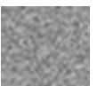
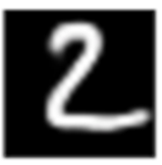

Answer: Example
Answer: Exercise 2(a): Auto-encoder training
For (epoch=1;epoch <max_epoch ; epoch++)
{For all 10,000 images{
Feed each clean image plus noise to the encoder input
Present the clean image of the numerical to the output of the decoder,
Use backpropagation to train the whole autoencoder network (encoder + decoder)
}
Break if Loss is too small
}
Autoencoder usage: If the trained encoder receives a noisy image of a handwritten numeral, what do you expect at the output?
Answer: a denoised image of the real numeral
Noise
clean image for numeral “2”
+
auto-encoder

Slide 18
Code: Part(i): obtain dataset and add noise https://towardsdatascience.com/how-to-reduce-image-noises-by-autoencoder-65d5e6de543
#part1 ---------------------------------------------------
np.random.seed(1337)
# MNIST dataset
(x_train, _), (x_test, _) = mnist.load_data()
image_size = x_train.shape[1]
x_train = np.reshape(x_train, [-1, image_size, image_size, 1])
x_test = np.reshape(x_test, [-1, image_size, image_size, 1])
x_train = x_train.astype('float32') / 255
x_test = x_test.astype('float32') / 255
# Generate corrupted MNIST images by adding noise with normal dist
# centered at 0.5 and std=0.5
noise = np.random.normal(loc=0.5, scale=0.5, size=x_train.shape)
x_train_noisy = x_train + noise
noise = np.random.normal(loc=0.5, scale=0.5, size=x_test.shape)
x_test_noisy = x_test + noise
x_train_noisy = np.clip(x_train_noisy, 0., 1.)
x_test_noisy = np.clip(x_test_noisy, 0., 1.)

Slide 19
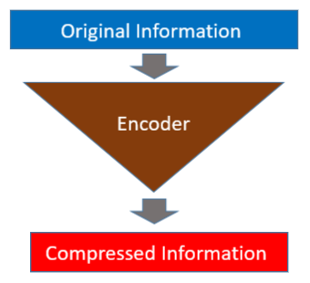
Part (ii):First build the Encoder Model
#part2 ---------------------------------------------------
# Network parameters
input_shape = (image_size, image_size, 1)
batch_size = 128
kernel_size = 3
latent_dim = 16
# Encoder/Decoder number of CNN layers and filters per layer
layer_filters = [32, 64]
# Build the Autoencoder Model
# First build the Encoder Model
inputs = Input(shape=input_shape, name='encoder_input')
x = inputs
# Stack of Conv2D blocks
# Notes:
# 1) Use Batch Normalization before ReLU on deep networks
# 2) Use MaxPooling2D as alternative to strides>1
# - faster but not as good as strides>1
for filters in layer_filters:
x = Conv2D(filters=filters,
kernel_size=kernel_size,
strides=2,
activation='relu',
padding='same')(x)
# Shape info needed to build Decoder Model
shape = K.int_shape(x)
# Generate the latent vector
x = Flatten()(x)
latent = Dense(latent_dim, name='latent_vector')(x)
# Instantiate Encoder Model
encoder = Model(inputs, latent, name='encoder')
encoder.summary()

Slide 20
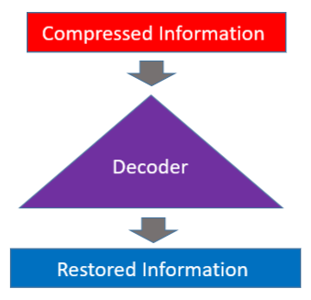
Part (iii):Build the Decoder Model
#part3 ---------------------------------------------------
# Build the Decoder Model
latent_inputs = Input(shape=(latent_dim,), name='decoder_input')
x = Dense(shape[1] * shape[2] * shape[3])(latent_inputs)
x = Reshape((shape[1], shape[2], shape[3]))(x)
# Stack of Transposed Conv2D blocks
# Notes:
# 1) Use Batch Normalization before ReLU on deep networks
# 2) Use UpSampling2D as alternative to strides>1
# - faster but not as good as strides>1
for filters in layer_filters[::-1]:
x = Conv2DTranspose(filters=filters,
kernel_size=kernel_size,
strides=2,
activation='relu',
padding='same')(x)
x = Conv2DTranspose(filters=1,
kernel_size=kernel_size,
padding='same')(x)
outputs = Activation('sigmoid', name='decoder_output')(x)
# Instantiate Decoder Model
decoder = Model(latent_inputs, outputs, name='decoder')
decoder.summary()
# Autoencoder = Encoder + Decoder
# Instantiate Autoencoder Model
autoencoder = Model(inputs, decoder(encoder(inputs)), name='autoencoder')
autoencoder.summary()
autoencoder.compile(loss='mse', optimizer='adam')

Slide 21
Part (iv): Train the autoencoder, decode images display result
#part4 ---------------------------------------------------
# Train the autoencoder
autoencoder.fit(x_train_noisy,
x_train,
validation_data=(x_test_noisy, x_test),
epochs=30,
batch_size=batch_size)
# Predict the Autoencoder output from corrupted test images
x_decoded = autoencoder.predict(x_test_noisy)
# Display the 1st 8 corrupted and denoised images
rows, cols = 10, 30
num = rows * cols
imgs = np.concatenate([x_test[:num], x_test_noisy[:num], x_decoded[:num]])
imgs = imgs.reshape((rows * 3, cols, image_size, image_size))
imgs = np.vstack(np.split(imgs, rows, axis=1))
imgs = imgs.reshape((rows * 3, -1, image_size, image_size))
imgs = np.vstack([np.hstack(i) for i in imgs])
imgs = (imgs * 255).astype(np.uint8)
plt.figure()
plt.axis('off')
plt.title('Original images: top rows, '
'Corrupted Input: middle rows, '
'Denoised Input: third rows')
plt.imshow(imgs, interpolation='none', cmap='gray')
Image.fromarray(imgs).save('corrupted_and_denoised.png')
plt.show()

Slide 22
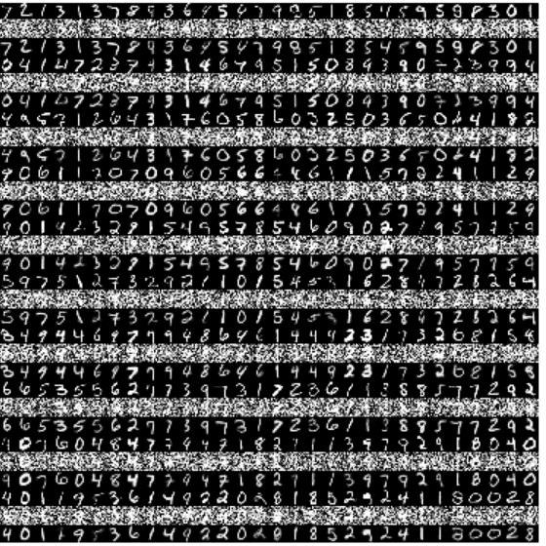
Code https://towardsdatascience.com/how-to-reduce-image-noises-by-autoencoder-65d5e6de543 Result: plt.title('Original images: top rows, ' 'Corrupted Input: middle rows, ' 'Denoised Input: third rows')
'''Trains a denoising autoencoder on MNIST dataset.
https://towardsdatascience.com/how-to-reduce-image-noises-by-autoencoder-65d5e6de543
Denoising is one of the classic applications of autoencoders.
The denoising process removes unwanted noise that corrupted the
true signal.
Noise + Data ---> Denoising Autoencoder ---> Data
Given a training dataset of corrupted data as input and
true signal as output, a denoising autoencoder can recover the
hidden structure to generate clean data.
This example has modular design. The encoder, decoder and autoencoder
are 3 models that share weights. For example, after training the
autoencoder, the encoder can be used to generate latent vectors
of input data for low-dim visualization like PCA or TSNE.
'''
#keras>> tensorflow.keras, modification by khw
from __future__ import absolute_import
from __future__ import division
from __future__ import print_function
import tensorflow.keras as keras
from tensorflow.keras.layers import Activation, Dense, Input
from tensorflow.keras.layers import Conv2D, Flatten
from tensorflow.keras.layers import Reshape, Conv2DTranspose
from tensorflow.keras.models import Model
from tensorflow.keras import backend as K
from tensorflow.keras.datasets import mnist
import numpy as np
import matplotlib.pyplot as plt
from PIL import Image
np.random.seed(1337)
# MNIST dataset
(x_train, _), (x_test, _) = mnist.load_data()
image_size = x_train.shape[1]
x_train = np.reshape(x_train, [-1, image_size, image_size, 1])
x_test = np.reshape(x_test, [-1, image_size, image_size, 1])
x_train = x_train.astype('float32') / 255
x_test = x_test.astype('float32') / 255
# Generate corrupted MNIST images by adding noise with normal dist
# centered at 0.5 and std=0.5
noise = np.random.normal(loc=0.5, scale=0.5, size=x_train.shape)
x_train_noisy = x_train + noise
noise = np.random.normal(loc=0.5, scale=0.5, size=x_test.shape)
x_test_noisy = x_test + noise
x_train_noisy = np.clip(x_train_noisy, 0., 1.)
x_test_noisy = np.clip(x_test_noisy, 0., 1.)
# Network parameters
input_shape = (image_size, image_size, 1)
batch_size = 128
kernel_size = 3
latent_dim = 16
# Encoder/Decoder number of CNN layers and filters per layer
layer_filters = [32, 64]
# Build the Autoencoder Model
# First build the Encoder Model
inputs = Input(shape=input_shape, name='encoder_input')
x = inputs
# Stack of Conv2D blocks
# Notes:
# 1) Use Batch Normalization before ReLU on deep networks
# 2) Use MaxPooling2D as alternative to strides>1
# - faster but not as good as strides>1
for filters in layer_filters:
x = Conv2D(filters=filters,
kernel_size=kernel_size,
strides=2,
activation='relu',
padding='same')(x)
# Shape info needed to build Decoder Model
shape = K.int_shape(x)
# Generate the latent vector
x = Flatten()(x)
latent = Dense(latent_dim, name='latent_vector')(x)
# Instantiate Encoder Model
encoder = Model(inputs, latent, name='encoder')
encoder.summary()
# Build the Decoder Model
latent_inputs = Input(shape=(latent_dim,), name='decoder_input')
x = Dense(shape[1] * shape[2] * shape[3])(latent_inputs)
x = Reshape((shape[1], shape[2], shape[3]))(x)
# Stack of Transposed Conv2D blocks
# Notes:
# 1) Use Batch Normalization before ReLU on deep networks
# 2) Use UpSampling2D as alternative to strides>1
# - faster but not as good as strides>1
for filters in layer_filters[::-1]:
x = Conv2DTranspose(filters=filters,
kernel_size=kernel_size,
strides=2,
activation='relu',
padding='same')(x)
x = Conv2DTranspose(filters=1,
kernel_size=kernel_size,
padding='same')(x)
outputs = Activation('sigmoid', name='decoder_output')(x)
# Instantiate Decoder Model
decoder = Model(latent_inputs, outputs, name='decoder')
decoder.summary()
# Autoencoder = Encoder + Decoder
# Instantiate Autoencoder Model
autoencoder = Model(inputs, decoder(encoder(inputs)), name='autoencoder')
autoencoder.summary()
autoencoder.compile(loss='mse', optimizer='adam')
# Train the autoencoder
autoencoder.fit(x_train_noisy,
x_train,
validation_data=(x_test_noisy, x_test),
epochs=30,
batch_size=batch_size)
# Predict the Autoencoder output from corrupted test images
x_decoded = autoencoder.predict(x_test_noisy)
# Display the 1st 8 corrupted and denoised images
rows, cols = 10, 30
num = rows * cols
imgs = np.concatenate([x_test[:num], x_test_noisy[:num], x_decoded[:num]])
imgs = imgs.reshape((rows * 3, cols, image_size, image_size))
imgs = np.vstack(np.split(imgs, rows, axis=1))
imgs = imgs.reshape((rows * 3, -1, image_size, image_size))
imgs = np.vstack([np.hstack(i) for i in imgs])
imgs = (imgs * 255).astype(np.uint8)
plt.figure()
plt.axis('off')
plt.title('Original images: top rows, '
'Corrupted Input: middle rows, '
'Denoised Input: third rows')
plt.imshow(imgs, interpolation='none', cmap='gray')
Image.fromarray(imgs).save('corrupted_and_denoised.png')
plt.show()

Slide 23
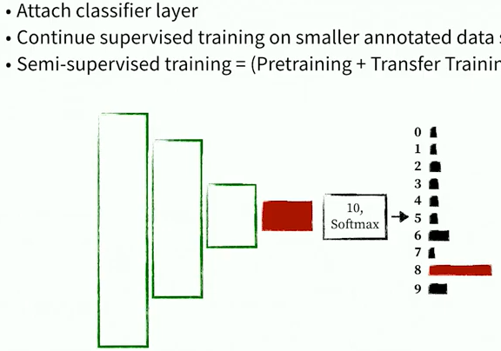
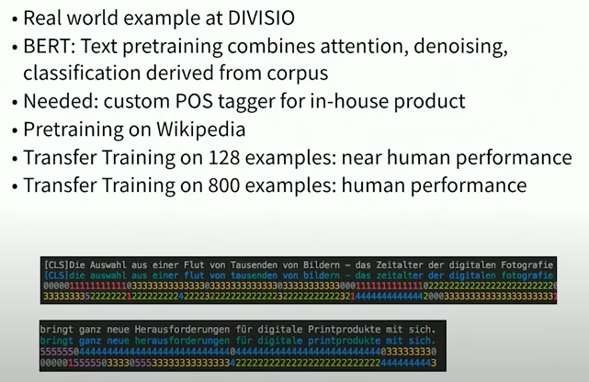
Pre-Training

Slide 24
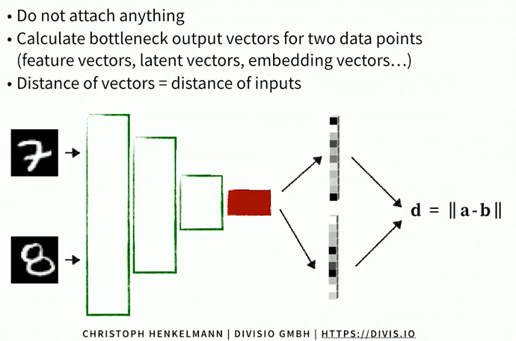
Similarity Detection

Slide 25
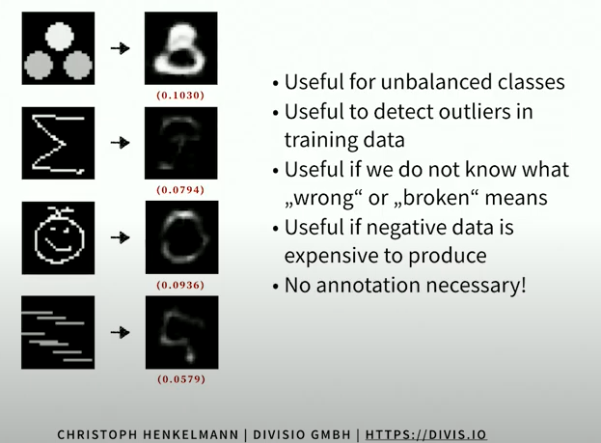
Anomaly detection

Slide 26
applications of a Vanilla (traditional) autoencoder
See https://en.wikipedia.org/wiki/Autoencoder
Dimensionality Reduction
Relationship with principal component analysis (PCA)
Information Retrieval
Anomaly Detection
Image Processing
Drug discovery

Slide 27
Some math background is needed:
https://ljvmiranda921.github.io/notebook/2017/08/13/softmax-and-the-negative-log-likelihood/
See appendix2: The expected negative log likelihood
Conditional expectation etc.

Slide 28
Part 2: Variational autoencoder
Will learn
Learn what is Variational autoencoder
How to train it?
How to use it?

Slide 29
Variational Autoencoder (VAE) v.s. Traditional Autoencoder
Autoencoders (vanilla or traditional)
During training you present a pattern with artificial added noise to the encoder, and feed the same input pattern to the output. Then, use backpropagation to train the Autoencoder network.
So it is unsupervised learning (no label data is needed).
It can be used for data compression and noise removal.
During recall, when a noisy pattern is presented to the input, a de-noise image will appear at the output.
Variational autoencoders
Instead of learning from an input pattern, Variational autoencoders learn the parameters of a probability distribution function from the input patterns. We then use the parameters learned to generate new data. So it is a generative model similar to GAN (Generative Adversarial Network) in function.

Slide 30
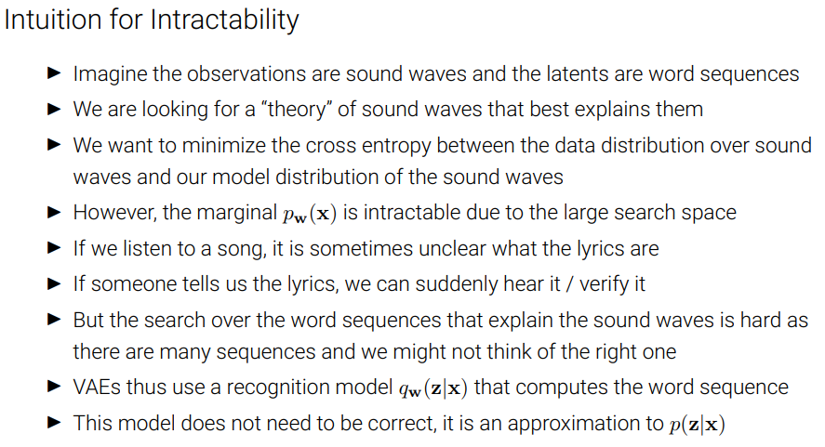

Slide 31
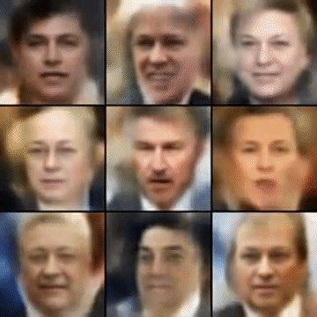
Variational autoencoder https://jaan.io/what-is-variational-autoencoder-vae-tutorial/
Variational autoencoders are cool. They let us design complex generative models of data, and fit them to large datasets. They can generate images of fictional celebrity faces and high-resolution digital artwork.
VAE faces
VAE faces demo
VAE MNIST
VAE street addresses
https://jaan.io/what-is-variational-autoencoder-vae-tutorial/
May be or similar to that used in software such as Deepfake (https://en.wikipedia.org/wiki/Deepfake)
FICTIONAL CELEBRITY FACES GENERATED BY A VARIATIONAL AUTOENCODER (BY ALEC RADFORD).

Slide 32
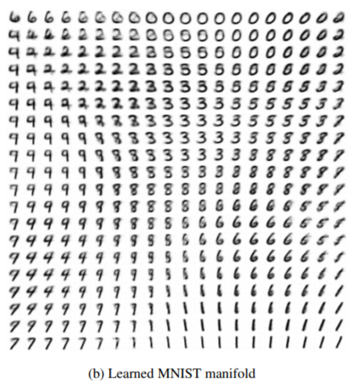
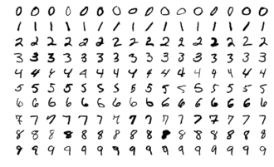
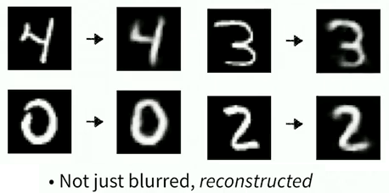
Example: Applying VAE for MNIST data set extension
Input: original image data set
Output: generated image
Dataset (images extended)
https://arxiv.org/pdf/1312.6114.pdf

Slide 33
Some background: Univariate and Multivariate Gaussian
https://ttic.uchicago.edu/~shubhendu/Slides/Estimation.pdf
Notes:
subsection{Uni-variate and Multivariate Gaussian}
%https://ttic.uchicago.edu/~shubhendu/Slides/Estimation.pdf
$N_{univariate}(x)=\frac{1}{(2\pi \sigma^2)^{(1/2)}}
exp\big( -\frac{1}{2}\frac{(x-\mu)^2}{\sigma^2}
\big)$\\
Multivariate Gaussian, $x$=data sample, %$\mu$=mean, $\sum$=covariance \\
d-dimension\\
$N_{univariate}(x)=
\frac{1}{(2\pi)^{(d/2)} | \Sigma |^{(1/2)}}
exp\big( -\frac{1}{2}(x-\mu)^T \Sigma^{-1}(x-\mu)
\big)$

Slide 34
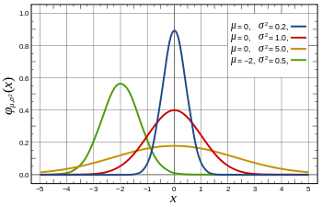

Properties of Gaussian (Normal) distribution
Standard Normal distribution (1-dimension):
Red line, when mean(μ)=0, Sigma (σ)=1
At (x-μ)=0, σ =1
G(x) =1/sqrt(2*pi)=0.3989
At x=1*σ, drops off to
(1/sqrt(2*pi))*exp(-1^1/2)=0.2420
Area covered 68.2%
At x=2*σ, drops off to
(1/sqrt(2*pi))*exp(-2^2/2)= 0.0540
Area covered 95.44%
At x=3*σ, drops off to
(1/sqrt(2*pi))*exp(-2^2/2)= ?? (exercise)
Area covered 99.73%
Probability density function
G
sets the horizontal shift
Controls the shape
G
Standard Normal distribution
Area covered
(total=
100%)
http://en.wikipedia.org/wiki/Normal_distribution
So called 95% confident value µ(+/-)2σ

Slide 35
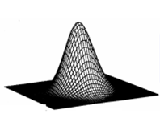
Gaussian (Normal) functions 1D,2D
G(x)
1-D Gaussian
x
μ
2-D Gaussian
y
x
μ_{y}
μ_{x}
Notes:
%%%%%%%%%%%% slide 54 %%%%%%%%%%%%%%%%%%%%
%%% eeeeee eq:filtering_01A eeeeeeeeeeeeeeeeeeeeeeeeeeeeeeeeee
%%%
1st order (A) Gaussian
\begin{flalign}
\label{eq:filtering_01a}
\begin{aligned}
G(x) = \frac{1}
{\sqrt{2\pi{\sigma^2 }}}
e^{-
\frac{(x-\mu)^2}
{2\sigma^2}
}
\end{aligned}
\end{flalign}
%%% eeeeee eq:filtering_01B eeeeeeeeeeeeeeeeeeeeeeeeeeeeeeeeee
1st order (B) Gaussian\\
\begin{flalign}
\label{eq:filtering_01b}
\begin{aligned}
G(x) = \frac{1}
{\sqrt{2\pi{\sigma^2 }}}
exp\left({-
\frac{(x-\mu)^2}
{2\sigma^2}
}\right)
\end{aligned}
\end{flalign}
%%%%%%%%%%%%%%%%%%%%%%%%%%%%%%%%%
%%% eeeeee eq:filtering_02A eeeeeeeeeeeeeeeeeeeeeeeeeeeeeeeeee
%%%%%%%%%%%%%%%%%%%%%%%%%%%%%%%%%
2nd order (A) Gaussian\\
\begin{flalign}
\label{eq:filtering_02A}
\begin{aligned}
G(x,y) =G(x)G(y)= \frac{1}
{{2\pi{\sigma^2 }}}
e^{-
\frac{(x-\mu_x)^2+(y-\mu_y)^2}
{2\sigma^2}
}
\end{aligned}
\end{flalign}
%%%
2nd order (B) Gaussian
%%% eeeeee eq:filtering_02B eeeeeeeeeeeeeeeeeeeeeeeeeeeeeeeeee
\begin{flalign}
\label{eq:filtering_02B}
\begin{aligned}
G(x,y) =G(x)G(y)= \frac{1}
{{2\pi{\sigma^2 }}}
exp\left({-
\frac{(x-\mu_x)^2+(y-\mu_y)^2}
{2\sigma^2}
}\right)
\end{aligned}
\end{flalign}

Slide 36
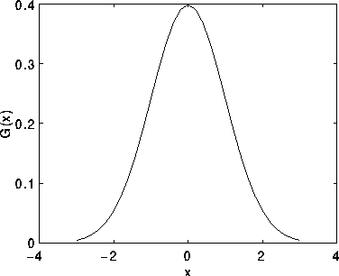
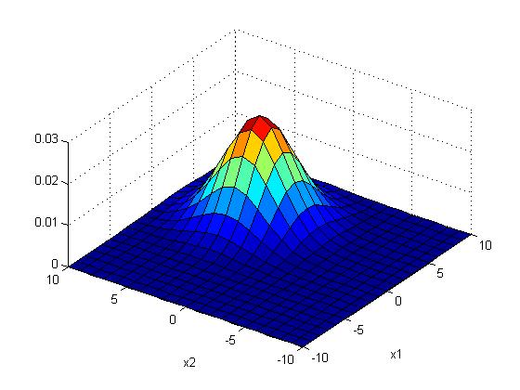
Example : A 1-D and 2-D Gaussian distribution
%2-D Gaussian distribution P(x_{j})
%matlab code----------
clear, N=10
[X1,X2]=meshgrid(-N:N,-N:N);
sigma =2.5;mean=[3 3]'
G=1/(2*pi*sigma^2)*
(exp(-((X1-mean(1)).^2+(X2-mean(2)).^2)) /(2*sigma^2));
G=G./sum(G(:)) %normalise it
'sigma is ', sigma
'sum(G(:)) is ',sum(G(:))
'max(max(G(:))) is',max(max(G(:)))
figure(1), clf
surf(X1,X2,G);
xlabel('x1'),ylabel('x2')
Notes:
%%%%%%%%%%%%%slide 28 %%%%%%%%%%%%%%%%%
1-D Gaussian $x_j$= a sample,\\
$\mu_0=mean, \sigma_0=variance$\\
$N(x_j)=\frac{1}{(2 \pi \sigma_0^2)^{1/2}}
exp \big (-\frac{1}{2}\frac{(x_j - \mu_0)^2}{\sigma_0^2} \big)$\\
%%%%%%%%%%%%%%%%%%%%%%%%%%%%%%
2-D an isotropic (circular symmetric) Gaussian \\
assume mean is 0\\
$N(x_1,x_2)=\frac{1}{(2 \pi \sigma_0^2)}
exp \big (-\frac{1}{2}\frac{(x_1^2+x_2^2 )^2}{\sigma_0^2} \big)$\\

Slide 37
Exercise 4
x=m_{x}
y=m_{y}
x=1+m_{x}
y=m_{y}
Fill in the blanks of this Gaussian mask of size 9x9 , sigma (σ)=2
Sketch the function
G(x,y)=
0.0007 0.0017 0.0033 0.0048 0.0054 0.0048 0.0033 0.0017 0.0007
0.0017 0.0042 0.0078 0.0114 0.0129 0.0114 0.0078 0.0042 0.0017
0.0033 0.0078 0.0146 0.0213 0.0241 0.0213 0.0146 0.0078 0.0033
0.0048 0.0114 0.0213 0.0310 0.0351 0.0310 0.0213 0.0114 0.0048
0.0054 0.0129 0.0241 0.0351 ____? ____? 0.0241 0.0129 0.0054
0.0048 0.0114 0.0213 0.0310 0.0351 ____? 0.0213 0.0114 0.0048
0.0033 0.0078 0.0146 0.0213 0.0241 0.0213 0.0146 0.0078 0.0033
0.0017 0.0042 0.0078 0.0114 0.0129 0.0114 0.0078 0.0042 0.0017
0.0007 0.0017 0.0033 0.0048 0.0054 0.0048 0.0033 0.0017 0.0007
Notes:
%%%%%%%%%%slide 29 , 30%%%%%%%%%%%%%%%%%%%%
---------------slide 29,30 \\
2-D an isotropic (circular symmetric) Gaussian for variable $(x,y)$ \\
assume 2-D mean is $(m_x,m_y)$\\
$G(x,y)=G(x)G(y)$\\
$N(x_1,x_2)=\frac{1}{(2 \pi \sigma_0^2)}
exp \big (-\frac{1}{2}\frac{((x-m_x)^2+(y-m_y)^2 )^2}{\sigma_0^2} \big)$\\

Slide 38
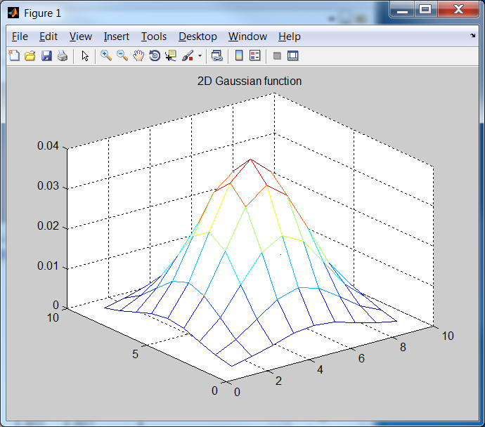
Answer: Exercise 4
1/(2*pi*2^2)*exp(-1/8)
x=m_{x}
y=m_{y}
x=1+m_{x}
y=m_{y}
1/(2*pi*2^2)
1/(2*pi*2^2)*exp(-2/8)
Fill in the blanks Gaussian mask of size the 9x9 , sigma (σ)=2
0.0007 0.0017 0.0033 0.0048 0.0054 0.0048 0.0033 0.0017 0.0007
0.0017 0.0042 0.0078 0.0114 0.0129 0.0114 0.0078 0.0042 0.0017
0.0033 0.0078 0.0146 0.0213 0.0241 0.0213 0.0146 0.0078 0.0033
0.0048 0.0114 0.0213 0.0310 0.0351 0.0310 0.0213 0.0114 0.0048
0.0054 0.0129 0.0241 0.0351 0.0398 0.0351 0.0241 0.0129 0.0054
0.0048 0.0114 0.0213 0.0310 0.0351 0.0310 0.0213 0.0114 0.0048
0.0033 0.0078 0.0146 0.0213 0.0241 0.0213 0.0146 0.0078 0.0033
0.0017 0.0042 0.0078 0.0114 0.0129 0.0114 0.0078 0.0042 0.0017
0.0007 0.0017 0.0033 0.0048 0.0054 0.0048 0.0033 0.0017 0.0007
clear %matlab
sigma=2 % in matlab , no -ve index for looping, so shift center to (5,5)
mean_x=5 , mean_y=5
for y=1:9
for x=1:9
g(x,y)=(1/(2*pi*sigma^2))*exp(-((x-mean_x)^2+(y-mean_y)^2) /(2*sigma^2))
end
end
mesh(g)
title('2D Gaussian function')
Notes:
%%%%%%%%%%slide 29 , 30%%%%%%%%%%%%%%%%%%%%
---------------slide 29,30 \\
2-D an isotropic (circular symmetric) Gaussian for variable $(x,y)$ \\
assume 2-D mean is $(m_x,m_y)$\\
$G(x,y)=G(x)G(y)$\\
$N(x_1,x_2)=\frac{1}{(2 \pi \sigma_0^2)}
exp \big (-\frac{1}{2}\frac{((x-m_x)^2+(y-m_y)^2 )^2}{\sigma_0^2} \big)$\\

Slide 39
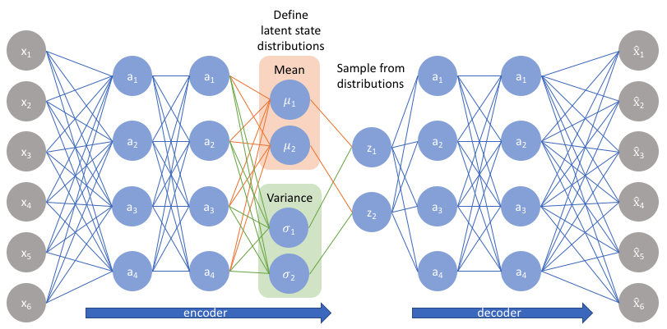
Variational autoencoder
A neural network view
Multivariate Gaussian:
Mean = µ
σ = standard dedication
Variance = σ²
https://www.jeremyjordan.me/variational-autoencoders/

Slide 40
Generative Models concept
It is an unsupervised learning method that generates new samples by using training data from the same distribution
E.g. You have limited number of samples, but want to create more samples of the same probability distributions to be used in machine learning purposes. Others include:
Creating new cartoon figures
Generating faces from images of celebrities.
Creating new fashions.
Creating new written characters for training optical character recognition systems of some languages
Generative model algorithms
Variational autoencoder
Generative adversarial network (GAN) not discussed here

Slide 41
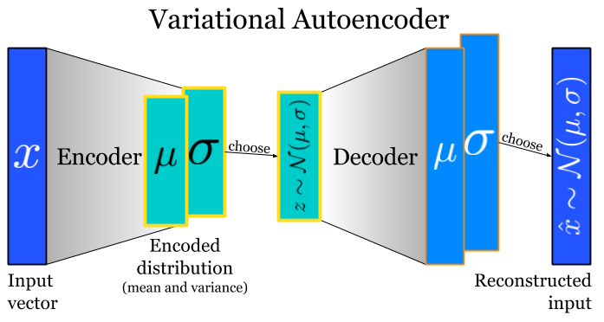
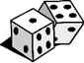
Variational autoencoder for generative models
Use training samples to train hidden data (parameters of multi-variate Gaussian standard deviations=σ_{s}, means = µ_{s} ). After training you may create new output from some input and weighted σ_{s} and µ_{s} . You may change the weights of σ_{s} and µ_{s} for a variety of related different outputs.
parameters of multi-variate Gaussian standard deviations= σ_{s}, means= µ_{s} )
E.g. 50µ_{s}, 30σ_{s}
https://www.quora.com/Whats-the-difference-between-a-Variational-Autoencoder-VAE-and-an-Autoencoder

Slide 42
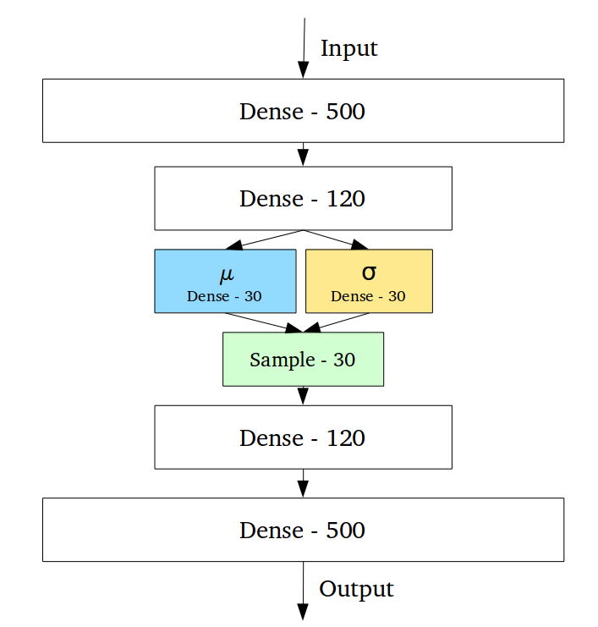
Application example: Use Generative Models for MNIST data extension http://yann.lecun.com/exdb/mnist/
MNIST original data set
During training , patterns are fed into input and output one by one, learn µ,σ by minimize loss
After training, data generation phase
Generated extended data set
z
Random generator layer using 30µ_{s}, 30σ_{s}

Slide 43

Exercise 5
Vanilla autoencoder
What is the architectural difference between Vanilla (traditional) autoencoder and Variational autoencoder?
Answer:
z
E.g. 30µ_{s}, 30σ_{s}

Slide 44
Answer: Exercise 5
What is the architectural difference between Vanilla (traditional) autoencoder and Variational autoencoder?
Answer:
Vanilla (traditional) autoencoder: input to output are directly connected by neurons and weights.
Variational autoencoder: The encoder turns input (x) into means (µ_{s}) and standard deviations (σ_{s}) of a multivariate Gaussian distribution, then use a random sampling method to create the output
Vanilla autoencoder
z
E.g. 30µ_{s}, 30σ_{s}

Slide 45
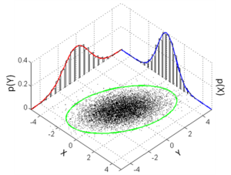
Exercise 6
(a) Discuss what is a multivariate-Gaussian distribution.
(b) Why is it difficult to find the means (µ_{s}) and standard deviations (σ_{s}) of a multivariate-Gaussian distribution in the Variational autoencoder (VAE) for generative models?
form
https://en.wikipedia.org/wiki/Multivariate_normal_distribution
of 2 dimensions

Slide 46
Answer: Exercise 6
(a) Answer: Multivariate-dimensional Gaussian:
In probability theory and statistics, the multivariate normal distribution, multivariate Gaussian distribution, or joint normal distribution is a generalization of the one-dimensional (univariate) normal distribution to higher dimensions. One definition is that a random vector is said to be k-variate normally distributed if every linear combination of its k components has a univariate normal distribution.
(b) Answer: Because the search space is large, there are too many combinations of means (µ_{s}) and standard deviations (σ_{s}) for generating the same output.
Answer (a): form
https://en.wikipedia.org/wiki/Multivariate_normal_distribution
of 2 dimensions

Slide 47
Example of variational autoencoder
Neural network
Random generator layer
By random sampling
Z
https://towardsdatascience.com/intuitively-understanding-variational-autoencoders-1bfe67eb5daf

Slide 48
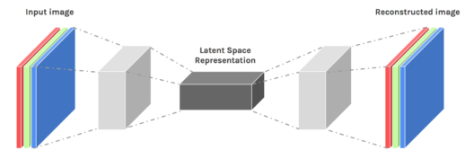
Training of Vanilla and Variational Autoencoders
Training of variational autoencoders is similar to training the vanilla autoencoders. E.g. for the de-noised application, presents noisy images to the input and clean image versions to the output. Use backpropagation to train the network. Read our previous discussion on vanilla autoencoder
http://www.math.purdue.edu/~buzzard/MA598-Spring2019/Lectures/Lec18%20-%20VAE.pptx
https://www.edureka.co/blog/autoencoders-tutorial/

Slide 49
Variational Autoencoder (VAE)
https://jaan.io/what-is-variational-autoencoder-vae-tutorial/
Z=Latent
Variables
By sampling
The latent variables, Z, are drawn from a probability distribution depending on the input, X, and the reconstruction is chosen probabilistically from z.
That means after you obtained mean=µ,variance σ², sample from X (n=500 neurons) to get Z (k=30 neurons)
X=(x₁,x₂,…………,x_{n})
Z=(z₁,z₂,…,z_{k})
Encoder
Q_{θ} (z|X)
Decoder
P_{φ} (X|z)
Z
Z=Sample from
a distribution
N(µ,σ)
https://jaan.io/what-is-variational-autoencoder-vae-tutorial/

Slide 50
Three difficult concepts in VAE
Train the neural network to maximize input/output likelihood
Use of Divergence (D_{KL})
Reparameterization

Slide 51
Variational Autoencoders VAE Concept 1
Train the neural network to maximize input/output likelihood
Tutorial on Variational Autoencoders
Carl Doersch
https://arxiv.org/abs/1606.05908

Slide 52
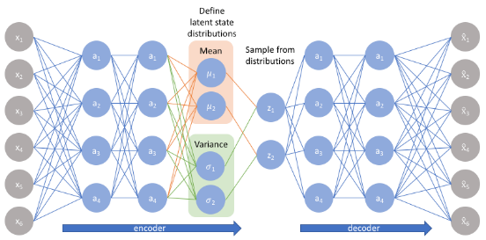
VAE Encoder
X-> encoder –>Z->decoder x^
https://jaan.io/what-is-variational-autoencoder-vae-tutorial/
The Encoder q_{θ(en)}(z|x) takes input x and returns Hidden parameters Z (random generated from µ,σ). (θ=encoder parameters. weights/biases)
From Z, use sampling to create input to the decoder
Encoders and Decoders are neural networks (NN)
Parameters in the NN are needed to be learned – so we have to set up a loss function.
Input
Data
Hidden
Z
Encoder(X→Z)
q_{θ(en)}(z|x)
Decoder(Z→ )
https://jaan.io/what-is-variational-autoencoder-vae-tutorial/
http://gregorygundersen.com/blog/2018/04/29/reparameterization/

Slide 53
VAE Decoder
https://jaan.io/what-is-variational-autoencoder-vae-tutorial/
The decoder takes hidden variable Z (gen. from means and standard deviations) as input, and reconstructs the image using random sampling methods. ( φ=decoder parameters weights/biases)
Encoders and Decoders are Neural Networks (NN)
Parameters (θ ,φ) in the NN are needed to be learned – so we have to set up a loss function.
Input
Data
Hidden
Z
Encoder(X→Z)
q_{θ(en)}(z|x)
Decoder(Z→ )
https://jaan.io/what-is-variational-autoencoder-vae-tutorial/

Slide 54
The reconstruction loss =(l ^{(rec)} )= “expected negative log-likelihood” of VAE
Given x_{i} ∈X, z∈Q, E() is expected value
The idea is to train the Encoder/Decoder (Neural Network) to maximum the likelihood (or minimize binary_cross_entropy (BCE) or Mean squared error (MSE) between x and reconstructed
To maximize likelihood, we minimize the reconstruction loss=“expected negative log-likelihood” (l_{i} ) of the i-th datapoint x_{i}. (see appendix 2)
Hidden
Z (µ,σ)
Encoder
q_{θ(en)}(z|x_{i})
Decoder
BCEor
MSE
Notes:
%%%%%%%%%%slide 46%%%%%%%%%%%%%%%%%%%%
---------------slide 46 \\
\subsection{slide 46:The reconstruction loss $l()$}
Given $x_i \epsilon X, z \epsilon Q, \text { and } E()$ is the expected value
The idea is to train the Encoder/Decoder (Neural Network) to maximum the likelihood of the Mean squared error (MSE) between x and reconstructed $\hat x_i \epsilon \hat X$\\
%
To maximize likelihood, we can minimize the “expected negative log-likelihood” $(l_i)$ of the $ i^{th}$ datapoint $x_i$. \\
%
$ l_i(\theta, \phi | x_i)=-E_{x_i \epsilon X} \big[
E_{z \epsilon Q}[log P_{\phi (de)}(\hat x_i | z)]
\big]$\\
$q_{\theta(en)}(z|x_i)$\\
$P_{\phi(de)}(\hat x_i |z)$\\
%
$l_i(\theta,\phi)$\\

Slide 55
Variational Autoencoders VAE Concept 2
Use of Divergence (D_{KL}):
Similar training images should produce similar hidden data (means and standard deviations)
http://mi.eng.cam.ac.uk/~mjfg/local/4F10/lect4.pdf
https://en.wikipedia.org/wiki/Kullback%E2%80%93Leibler_divergence
https://jhui.github.io/2017/03/06/Variational-autoencoders/ (for relating covariance and standard deviations, with good example)

Slide 56
How to make sure the neural networks produce similar hidden data (means & standard deviations) from similar training images
Problem: Input that we regard as similar may end up very different in z space (hidden, means and standard deviations). That means some solutions may give small loss l_{i} ^{(all)}(θ, φ ), even q_{θ(en)} and p_{φ(de)} are of very different distributions.
Solution: Use p(z)=N(0,1), try to force q_{θ(en)}(z|x_{i}) (a neural network) to act similar to a standard normal probability density function. We can use Kullback-Leibler divergence (D_{KL}) to do the checking.
We will minimize (L^{(all)} )
For encoder and decoder
We discussed this in concept 1:
This is for concept 2:
https://jaan.io/what-is-variational-autoencoder-vae-tutorial/
https://en.wikipedia.org/wiki/Kullback%E2%80%93Leibler_divergence
http://gregorygundersen.com/blog/2018/04/29/reparameterization/
Notes:
%%%%%%%%%%%%%%%%%%%%%%%%
\subsection{slide 48: How to make sure the neural networks produce similar hidden data (means and standard deviations) from similar training images}
Problem: Input that we regard as similar may end up very different in z space (hidden, means and standard deviations). That means some solutions may give small loss $l_i{(\theta, \phi)}$, even $q_{\theta(en)}$ and $p_{\phi(de)}$ are of very different distributions.\\
Solution: Use $p(z)=N(0,1)$, try to force $q_{\theta(en)}(z|x_i)$ (a neural network) to act similar to a standard normal probability density function. We can use Kullback-Leibler divergence $(D_{KL})$ to do the checking.
%
$l_i(\theta,\phi|x_i)$\\
$l_i()$

Slide 57
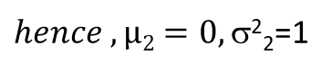
Math background: Kullback–Leibler divergence (also known as relative entropy) measures how one probability distribution is different from a second one, reference probability distribution over the same variable X.
For equation (I) See https://arxiv.org/pdf/1907.08956.pdf
https://en.wikipedia.org/wiki/Kullback%E2%80%93Leibler_divergence
$hence , µ2=0, $²₂=1
Kullback–Leibler divergence D_{KL} (D1|| D2)=0 indicates the two distributions D1,D2 are identical
Tutorial on Variational Autoencoders by Carl Doersch & https://arxiv.org/abs/1606.05908
Notes:
\subsection{Slide 49: Math background: Kullback–Leibler divergence}
%https://ttic.uchicago.edu/~shubhendu/Slides/Estimation.pdf
Math background: Kullback–Leibler divergence (also known as relative entropy) measures how one probability distribution is different from a second, reference probability distribution over the same variable X.
%1
Define:\\
$D_{KL}\big[
N(\mu_1,\sigma_1^2) || ( \mu_2,\sigma_2^2)
\big]=
\frac{1}{2} \Big[
tr \big ([\sigma_2^2]^T \cdot \sigma_1^2-I \big)
+(\mu_1-\mu_2)^T[\sigma^2]^{-1}(\mu_1 - \mu_2)
+log \big( \frac{det(\sigma_2^2)}{det(\sigma_1^2)} \big)
\Big]$-----(I)\\
If $N(\mu_1,\sigma_1^2)=N(\mu(X),\sigma^2(X))$;
\\Also $N(\mu_2,\sigma^2_2)=N(0,I)$\\
%2
%
$D_{KL}\big[
N(\mu(X),\sigma^2(X)) || ( N(0,I)
\big]=
\frac{1}{2} \Big[
tr \big ([\sigma^2]^T \cdot \sigma^2-I \big)
+(\mu(X))^T(\mu(X)))
-log (det(\sigma^2(X)))
\Big]$\\
%3
For $D[Q(z|x_i) || N(0,I)] \text{, where }
Q(z|x_i) =N(\mu(X),\sigma^2(X))$\\
$D_{KL}\big[
N(\mu(X),\sigma^2(X)) || ( N(0,I)
\big]=
\frac{1}{2} \Big[
tr \big ([\sigma^2]^T \cdot \sigma^2-I \big)
+(\mu(X))^T(\mu(X)))
-log (det(\sigma^2(X)))
\Big]$\\
Kullback–Leibler divergence $D_{KL} (D_1 || D_2)=0$ indicates the two distributions ${D_1,D_2}$ are identical
%Tutorial on Variational Autoencoders by Carl Doersch & https://arxiv.org/abs/1606.05908

Slide 58
Training: Combining concept 1 and 2 to minimize Loss l_{i} (X), of X= {x₁,x_{2,}..,x_{N}} , E()=expected value . For the whole X, the average loss is
See http://bjlkeng.github.io/posts/variational-autoencoders/ & https://arxiv.org/abs/1312.6114
Concept 1
Input, output mean
Notes:
\subsection{Slide50:Training (concept 1)}
%See http://bjlkeng.github.io/posts/variational-autoencoders/ & https://arxiv.org/abs/1312.6114
Combining concept 1 and 2 to minimize Loss $l_i (X), \text{ of } X= {x_1,x_2,..,x_N} , E()$=expected value . For the whole $X$, the average loss is \\
Input to encoder = $x_i \epsilon X$\\
Output to encoder = $\hat{x_i} \epsilon \hat{X}$\\
$P(\hat{x_i} | z)$=Prob. distribution of $x_i$ generated by $z$ (decoder side)\\
%
$P(z | x_i)$=Prob. distribution of $x_i$ generated by $z$ (decoder side)\\
%
$P(z)$=Prob. distribution of the latent (hidden) variables,\\
%
$E_{Z \epsilon Q}[log P(\hat x_i | z)]$=expected value (exp. val) of $\hat x_i$ generated at the decoder output\\
%
$E_{x_i \epsilon X}[E_{Z \epsilon Q}[log(P(\hat {x_i | z)})]]$=
exp. val. of $\hat{x_i}$ gen. at the decoder output when input = $x_i \epsilon X$ \\
%
$\varepsilon = \text { random variable generated by a Gaussian function }\{ mean (\mu)=0, stdev( \sigma)=1\}, \varepsilon N(0,I) $\\
%
At this stage $z$ can be any distribution, but we can assume $z$= Gaussian $N(\mu_{x_i|z}), \sigma_{x_i | z})$\\
%
It can be formed by scaling $\varepsilon \epsilon N(),I)$, (\url{en. https://en.wikipedia.org/wiki/Normal_distribution})\\
The advantage is if $(\mu_{x_i | z}, \sigma_{x_i | z)})$ are found, then use a random gen. $N(\mu_{x_i | z}, \sigma_{x_i | z})$ to gen. $z$.\\
%
Hence $log P(\hat{x_i} | z)=log P \big( \hat {x_i |z}=\mu_{x_i |z}(x_i)+\sigma_{x_i | z}(x_i) \ast \varepsilon \big)$ \\
%
We want to maximize $E_{x_i \epsilon X}[ E_{z_i \epsilon Q}[log P (\hat x_i | z]]$ (to make input output similar)\\
%
It is the same as to minimize $-\big( E_{x_i \epsilon X}[ E_{z_i \epsilon Q}[log P (\hat x_i | z]]
\big)$\\
Objective function1=$-E_{x_i | X}
\Big[ E_{z \epsilon Q}[
log P(\hat{x_i} | z=\mu_{x_i |z}(x_i)+\sigma_{x_i | z}(x_i) \ast \varepsilon )$ ]
\Big]\\
Since P is Gaussian, we minimize Objective$\_$function1=$\frac{1}{N}
\sum\limits_{x_i \epsilon X}
\Big( \frac{1}{2 \sigma^2_{\hat {x_i}} |z}
(x_i - \mu_{\hat{x_i}|z})^2
\Big)$

Slide 59
Training: Combining concept 1 and 2 to minimize Loss l_{i} (X), of X= {x₁,x_{2,}..,x_{N}} ,, E()=expected value . For the whole X, the average loss is
Concept 1:(reconstruction loss):
Concept 2:
See http://bjlkeng.github.io/posts/variational-autoencoders/ & https://arxiv.org/abs/1312.6114
Notes:
%%%%%%%%%%%%%%%%%%%%%%%%
\subsection{slide 51, concept2}
Training: Combining concept 1 and 2 to minimize Loss $l_i (X), of X= {x_1,x_2,..,x_N} , E()$=expected value . For the whole $X$, the average loss is
Recall $q_{\theta(en)(z|x_i)}$=prob.distribution of $z$ generated by $x_i$ (encoder side)\\
%
We mentioned earlier we want $q_{\theta(en)(z|x_i)}$ to be close to Gaussian, put $P(z)=N(0,I)$\\
%
$D_{KL}\big[
q_{\theta(en)}(z|x_i) || ( N(0,I)
\big]$=difference of $q_{\theta(en)(z|x_i)}$ and Gaussian, see previous discussion on $D_KL[]$\\
%
objective$\_$func2= $D_{KL}\big[
q_{\theta(en)(z|x_i)} || ( N(0,I)
\big]$, this is to be minimized\\
%
Overall$\_$objective$\_$function =objective$\_$funct1+objective$\_$func2\\
$=\frac{1}{N}
\sum\limits_{x_i \epsilon X}
\Big( \frac{1}{2 \sigma^2_{\hat {x_i}} |z}
(x_i - \mu_{\hat{x_i}|z})^2
\Big)
+D_{KL}\big[
q_{\theta(en)(z|x_i)} || ( N(0,I)
\big]$\\
We have shown earlier that\\
$D_{KL}\big[
q_{\theta(en)}(z|x_i) || ( N(0,I)
\big]=
%
+\frac{1}{2} \big\{
tr (\sigma^2(X)-I)
+\mu(X)^T \mu(X)-log(det(\sigma^2(X)))
\big\}$
%
%
%%
$l=\frac{1}{N}
\sum\limits_{x_i \epsilon X}
\Big( \frac{1}{2 \sigma^2_{\hat {x_i}} |z}
(x_i - \mu_{\hat{x_i}|z})^2
\Big)
+\frac{1}{2} \big\{
tr (\sigma^2(X)-I)
+\mu(X)^T \mu(X)-log(det(\sigma^2(X)))
\big\}$\\
The first term is for concept 1 and the second term is for concept 2\\
We will run an iterative algorithm to minimize $l$
See \url{ http://bjlkeng.github.io/posts/variational-autoencoders/ & https://arxiv.org/abs/1312.6114}

Slide 60
For VAE implementation
Input X=(x₁,x₂,…,x_{n})
Using the encoder, from X we obtain k different Gaussian distributions: N(mean_{j}, StdDev_{j}),
each z_{j}=generated by N(µ _{j} ,σ_{j}),where j =1,.,K,then we have Z=(z₁,z₂,.,z_{k})
See https://en.wikipedia.org/wiki/Kullback%E2%80%93Leibler_divergence
https://wiseodd.github.io/techblog/2016/12/10/variational-autoencoder/

Slide 61
In practice
we replace σ² with exp(σ²) to enable stability in calculation. And for the minimization of D_{KL}, this replacement gives the same result

Slide 62
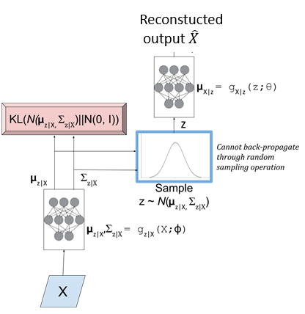
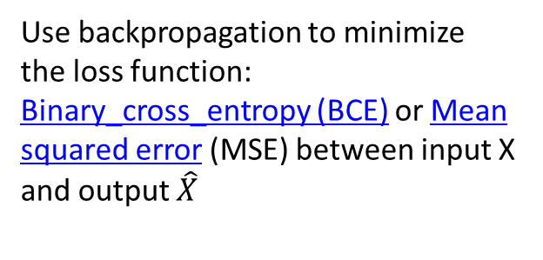
Use neural networks to implement the system
Use backpropagation to minimize
the loss function: Binary_cross_entropy (BCE) or Mean squared error (MSE) between input X and output $\hat{X}$
Use backpropagation to minimize
this loss function :
Decoder neural network
Encoder neural network
Concept 1
Concept 2
Input
Data
Notes:
\subsection{slide 52:Use neural networks to implement system}
$l=\frac{1}{N}
\sum\limits_{x_i \epsilon X}
\Big( \frac{1}{2 \sigma^2_{\hat {x_i}} |z}
(x_i - \mu_{\hat{x_i}|z})^2
\Big)
+\frac{1}{2} \big\{
tr (\sigma^2(X)-I)
+\mu(X)^T \mu(X)-log(det(\sigma^2(X)))
\big\}$\\

Slide 63
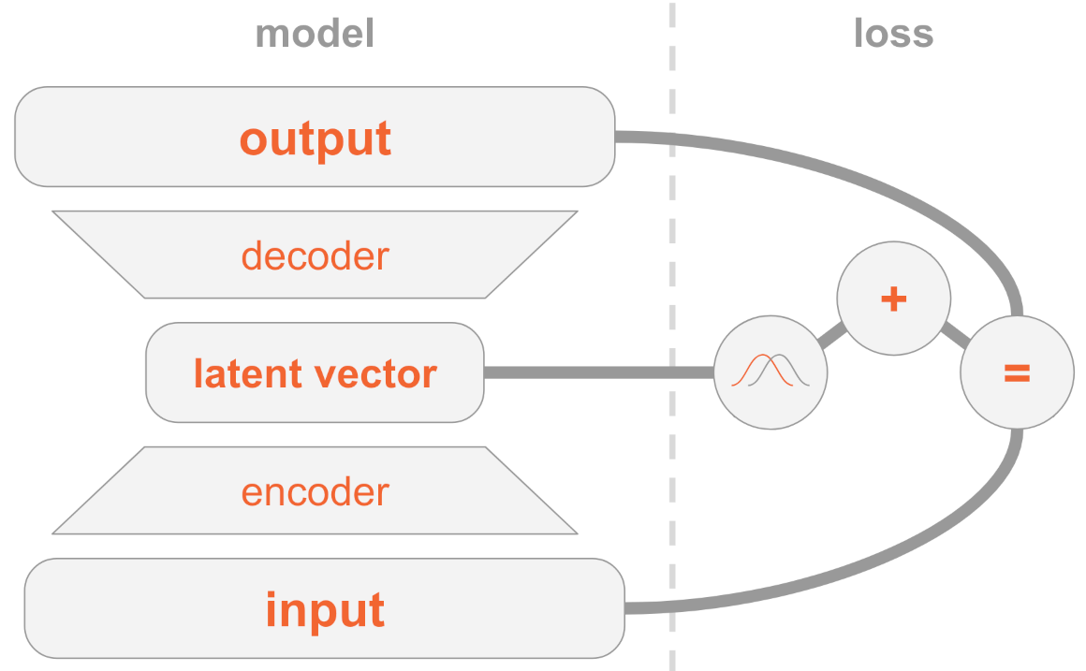
The training method
Minimize loss (L)
Input and output are similar
The latent vector represents Gaussian distributions
http://anotherdatum.com/vae.html

Slide 64
Variational Autoencoders VAE Concept 3
Reparameterization: the method to enable backpropagation for training neural network that involves random processes

Slide 65
VAE generative model
In theory, we can sample z_{i} from N(µ_{i} ,σ_{i} ) produced by the encoder. Note: N()=Gaussian Func.
Z is the input to the decoder to produce the output.
Alternatively, we find z by sampling ∈ (called epsilon or eps) from N(0,1) (Gaussian mean= 0, StdDev=1), then find z using : z_{i} =µ_{i} +∈*σ_{i}
Then z has mean = µ_{i} , StdDev= σ_{I} as required
See gen_data_using_mean0_sigma1.m in appendix
This is called Reparameterization,
Reason: therefore, we can back-propagate this function during training
Notes:
%%%%%%%%%%%%%%%%%%%%
\subsection{slide 55: VAE generative model}
In theory, we use a sample of z from $q_{\theta(en)} (z|x_i)$ as input to sample from $p_{\phi(de)}(\hat X_i| Z) $ to give an approximate reconstruction of $x_i$\\
Alternatively, if we sample any $z$ from $N(0,1)$ and use it as input to sample from $p_{\phi(de)}(\hat X_i | Z) $ then we can approximate the entire data distribution $p( )$. I.e., we can generate new samples that look like the input but aren’t in the input.

Slide 66
Train the variational-encoder
How to train the auto-encoder neural network?
Difficulty
Since a random process is involved, backpropagation cannot be executed
Solution
Use of the re-parameterization trick
Generate z by
random sampling

Slide 67
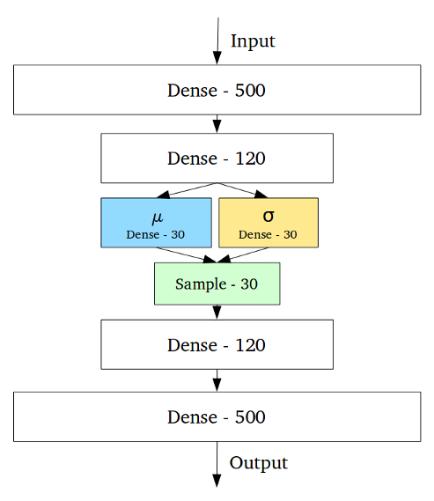
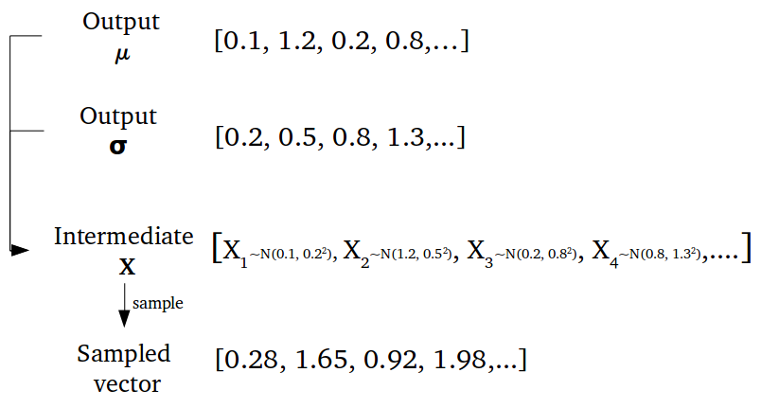
Training : an example
https://towardsdatascience.com/intuitively-understanding-variational-autoencoders-1bfe67eb5daf
example
Random generator layer
Z

Slide 68
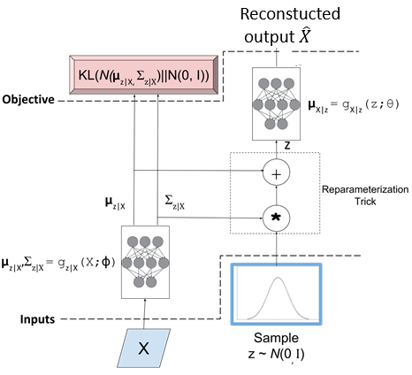
Learning algorithm : The probability function (left side diagram) cannot be back-propagated, therefore Reparameterization trick (right side diagram) should be applied
http://bjlkeng.github.io/posts/variational-autoencoders/
We also want the output to be similar to the input
This Q(z|x)
=N(µ_{z|X},σ_{z|X}) should be close to N(0,I)
P(X|z)
Random generator layer
StdDev=
σ
Solution:
Reparameterization trick
∈
Qq(z|x)
Problem:
Cannot backpropagate
Figure 4: A variational autoencoder with the "Reparameterization trick". Notice that all operations between the inputs and objectives are continuous deterministic functions, allowing back-propagation to occur.
Figure 3: An initial attempt at a variational autoencoder without the "Reparameterization trick". Objective functions shown in red. We cannot back-propagate through the stochastic sampling operation because it is not a continuous deterministic function.

Slide 69
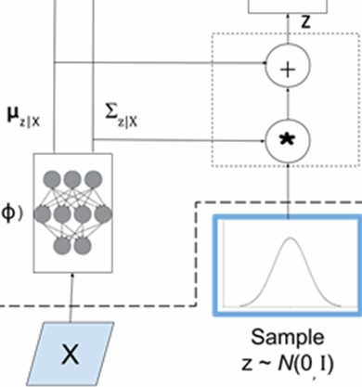
Intuition of the Parameterization trick
The encoder uses random sampling to generate z
Backpropagation (during training) is not possible for the random sampling process
Parameterization can produce the same effect for the encoder
Backpropagation (during training) is possible because no random process is involved
Backpropagation path
∈
Encoder
Path by random sampling

Slide 70
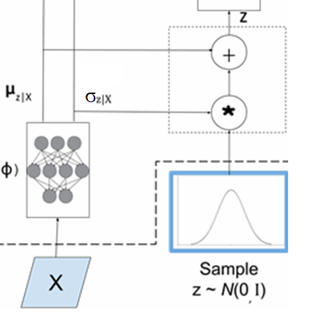
Reparameterization Z can be produced by a scaled N(0,I)
Reparameterization generates any Gaussian distribution of known mean (µ_{x}), standard-deviation (σ_{x}) by using the equation (Z= µ_{x}+ ∈σ_{x} ) based on the variable ∈ generated by N(0,1) .
After the forward pass, ∈ is generated, so ∈ is not random. It is a data to be used in backpropagation during training.
N(0,1) =Gaussian with mean=0 and standard deviation=1
∈ = the generated variable of N(0,1)
µ_{x} =mean
σ_{x} = standard-deviation
Z= µ_{x}+ ∈σ_{x}
mean
Standard deviation
∈
Input data
To produce the random variable ∈ N(0,1): mean =0, std=1
Notes:
%%%%%%%%%%%%%%%%%%%%
\subsection{slide 55: VAE generative model}
In theory, we use a sample of z from $q_{\theta(en)} (z|x_i)$ as input to sample from $p_{\phi(de)}(\hat X_i| Z) $ to give an approximate reconstruction of $x_i$\\
Alternatively, if we sample any $z$ from $N(0,1)$ and use it as input to sample from $p_{\phi(de)}(\hat X_i | Z) $ then we can approximate the entire data distribution $p( )$. I.e., we can generate new samples that look like the input but aren’t in the input.

Slide 71
https://learnopencv.com/variational-autoencoder-in-tensorflow/

Slide 72
Summary for reparameterization
∈ = the generated variable by sampling N(0,1)
µ_{x} = mean
σ_{x} = standard deviation
z= µ_{x} +∈ σ_{x} ; This equation is deterministic, so it can be backpropagate
See code in
https://learnopencv.com/variational-autoencoder-in-tensorflow/
Notes:
\subsection{slide 67: Summary: Forward pass}
$\epsilon$= the generated variable\\
$\mu$ = mean\\
$\sigma$= variance\\
$Z= \epsilon \sigma_x +\mu_x$

Slide 73
Exercise 7
Discuss why Reparameterization is needed.

Slide 74
Answer: Exercise 7 Discuss why Reparameterization is needed.
Answer: Z is generated by a random process if you have mean=µ_{x} , standardDev= σ_{x}. Since the VAE system is implemented using neural networks, they need backpropagation for training the weights/parameters, and the random process of generating Z cannot be backpropagated.
Solution: The reparameterization trick converts the random process into a determinization process (z= µ_{x} +∈ σ_{x} ) with the help of a random variable ∈ generated by a normal distributed random generated normal distribution with mean=0 and standardDev=1: N(0,1), hence this deterministic process can be backpropagated.
Reparameterization trick

Slide 75
Demo Matlab code: gen_data_using_mean0_sigma1.m to show the idea: X= µx+ σx * eps is the formula for generating X by eps (generated by normal distortion of mean=0, std=1) https://nbviewer.jupyter.org/github/gokererdogan/Notebooks/blob/master/Reparameterization%20Trick.ipynb
%gen_data_using_mean0_sigma1.m
clear
%%large number of samples %%
eps=randn(10000,1);
mu_x=2 %this is your mean
sigma_x=1 %this is your std
x=mu_x+(eps*sigma_x);
grad2_of_mean= sum(2*(mu_x+eps))/length(x);
'grad2 of mean='
grad2_of_mean
'mean(x)='
mean(x)
'std(x)='
std(x)
Result:grad2_of_mean = 3.9933
mean(x)= 1.9960 (approximate 2)
std(x)= 0.9984 (approximate 1)
σ_{x}= standard deviation of x
µ_{x} =mean of x
eps= N(mean=0,std=1), normal dist.
X= µ_{x}+ σ_{x} * eps
And gradient of mean is expected_val_of (2(eps+mu_x)), assume σ_{x}=1 for simplicity
The above is not random, because eps has been generated and µ_{x} is the current mean. We can use this in our backpropagation formula to find the updated mean.
Using X= µx+ σx * eps , we can find its gradient bypassing the random process. Because eps is generated by a random process during the neural net forward pass, during backpropagation this is the data (now available deterministically) to be used. Note:grad2_of_mean = expected_value_of (2(eps+mu_x))

Slide 76
Implementation
Using Keras
https://github.com/keras-team/keras/tree/master/

Slide 77
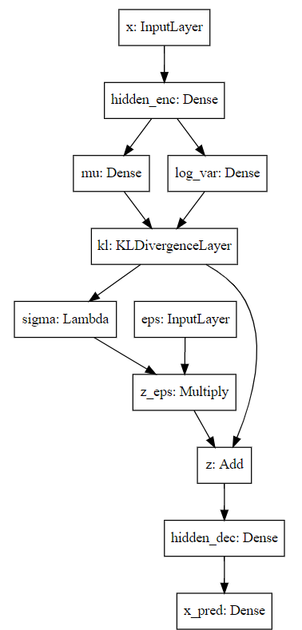
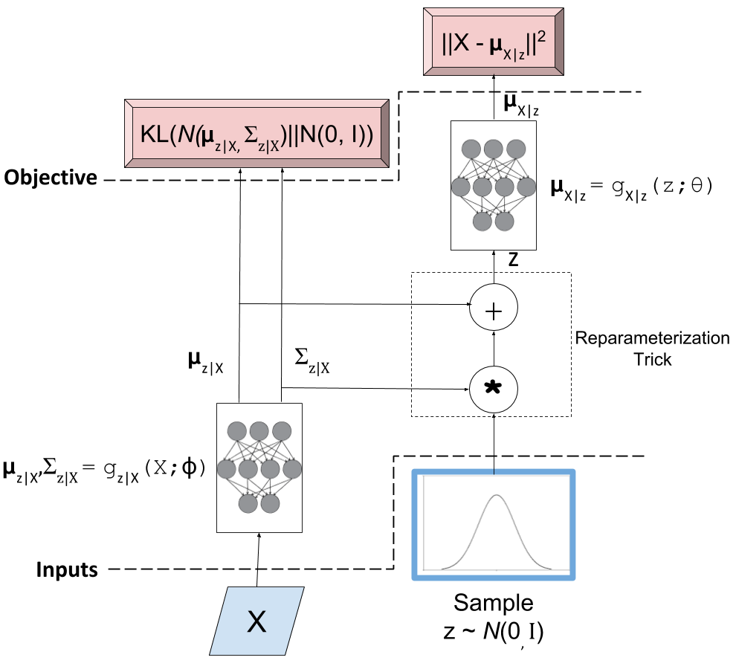
Keras
StdDev=
σ

Slide 78
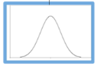
Keras implementation of VAE
original_dim = 784
intermediate_dim = 256
latent_dim = 2
batch_size = 100
epochs = 50
epsilon_std = 1.0
x = Input(shape=(original_dim,))
h = Dense(intermediate_dim, activation='relu')(x)
z_mu = Dense(latent_dim)(h)
z_log_var = Dense(latent_dim)(h)
z_mu, z_log_var = KLDivergenceLayer()([z_mu, z_log_var])
# Use of lambda: normalize log variance to std dev
z_sigma = Lambda(lambda t: K.exp(.5*t))(z_log_var)
eps = Input(tensor=K.random_normal(shape=(K.shape(x)[0],
latent_dim)))
z_eps = Multiply()([z_sigma, eps])
z = Add()([z_mu, z_eps])
decoder = Sequential([
Dense(intermediate_dim, input_dim=latent_dim, activation='relu'),
Dense(original_dim, activation='sigmoid')
])
x_pred = decoder(z)
StdDev=σ
Predicted output
http://louistiao.me/posts/implementing-variational-autoencoders-in-keras-beyond-the-quickstart-tutorial/

Slide 79
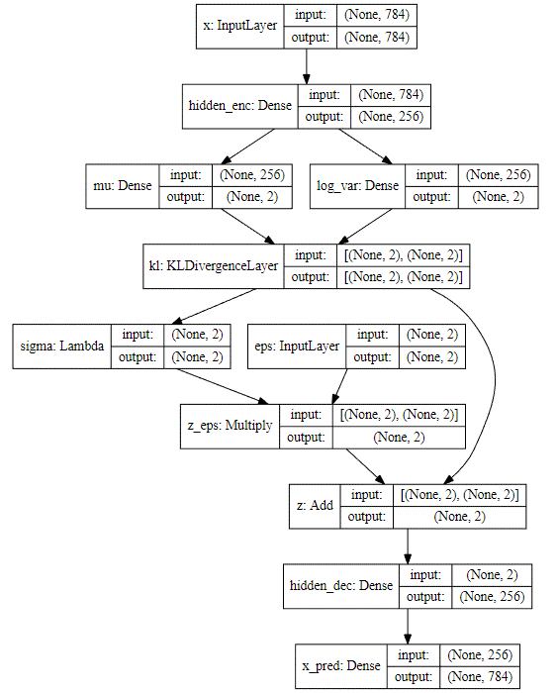
df
StdDev=
σ

Slide 80
variational_autoencoder_deconv .py from https://github.com/keras-team/keras/tree/master/
'''Example of VAE on MNIST dataset using CNN
The VAE has a modular design. The encoder, decoder and VAE
are 3 models that share weights. After training the VAE model,
the encoder can be used to generate latent vectors.
The decoder can be used to generate MNIST digits by sampling the
latent vector from a Gaussian distribution with mean=0 and std=1.
# Reference
[1] Kingma, Diederik P., and Max Welling.
"Auto-encoding variational bayes."
https://arxiv.org/abs/1312.6114
'''
from __future__ import absolute_import
from __future__ import division
from __future__ import print_function
from tensorflow.keras.layers import Dense, Input
from tensorflow.keras.layers import Conv2D, Flatten, Lambda
from tensorflow.keras.layers import Reshape, Conv2DTranspose
from tensorflow.keras.models import Model
from tensorflow.keras.datasets import mnist
from tensorflow.keras.losses import mse, binary_crossentropy
from tensorflow.keras.utils import plot_model
from tensorflow.keras import backend as K
import numpy as np
import matplotlib.pyplot as plt
import argparse
import os
# reparameterization trick
# instead of sampling from Q(z|X), sample eps = N(0,I)
# then z = z_mean + sqrt(var)*eps
def sampling(args):
"""Reparameterization trick by sampling fr an isotropic unit Gaussian.
# Arguments
args (tensor): mean and log of variance of Q(z|X)
# Returns
z (tensor): sampled latent vector
"""
z_mean, z_log_var = args
batch = K.shape(z_mean)[0]
dim = K.int_shape(z_mean)[1]
# by default, random_normal has mean=0 and std=1.0
epsilon = K.random_normal(shape=(batch, dim))
return z_mean + K.exp(0.5 * z_log_var) * epsilon
def plot_results(models,
data,
batch_size=128,
model_name="vae_mnist"):
"""Plots labels and MNIST digits as function of 2-dim latent vector
# Arguments
models (tuple): encoder and decoder models
data (tuple): test data and label
batch_size (int): prediction batch size
model_name (string): which model is using this function
"""
encoder, decoder = models
x_test, y_test = data
os.makedirs(model_name, exist_ok=True)
filename = os.path.join(model_name, "vae_mean.png")
# display a 2D plot of the digit classes in the latent space
z_mean, _, _ = encoder.predict(x_test,
batch_size=batch_size)
plt.figure(figsize=(12, 10))
plt.scatter(z_mean[:, 0], z_mean[:, 1], c=y_test)
plt.colorbar()
plt.xlabel("z[0]")
plt.ylabel("z[1]")
plt.savefig(filename)
plt.show()
filename = os.path.join(model_name, "digits_over_latent.png")
# display a 30x30 2D manifold of digits
n = 30
digit_size = 28
figure = np.zeros((digit_size * n, digit_size * n))
# linearly spaced coordinates corresponding to the 2D plot
# of digit classes in the latent space
grid_x = np.linspace(-4, 4, n)
grid_y = np.linspace(-4, 4, n)[::-1]
for i, yi in enumerate(grid_y):
for j, xi in enumerate(grid_x):
z_sample = np.array([[xi, yi]])
x_decoded = decoder.predict(z_sample)
digit = x_decoded[0].reshape(digit_size, digit_size)
figure[i * digit_size: (i + 1) * digit_size,
j * digit_size: (j + 1) * digit_size] = digit
plt.figure(figsize=(10, 10))
start_range = digit_size // 2
end_range = n * digit_size + start_range + 1
pixel_range = np.arange(start_range, end_range, digit_size)
sample_range_x = np.round(grid_x, 1)
sample_range_y = np.round(grid_y, 1)
plt.xticks(pixel_range, sample_range_x)
plt.yticks(pixel_range, sample_range_y)
plt.xlabel("z[0]")
plt.ylabel("z[1]")
plt.imshow(figure, cmap='Greys_r')
plt.savefig(filename)
plt.show()
# MNIST dataset
(x_train, y_train), (x_test, y_test) = mnist.load_data()
image_size = x_train.shape[1]
x_train = np.reshape(x_train, [-1, image_size, image_size, 1])
x_test = np.reshape(x_test, [-1, image_size, image_size, 1])
x_train = x_train.astype('float32') / 255
x_test = x_test.astype('float32') / 255
# network parameters
input_shape = (image_size, image_size, 1)
batch_size = 128
kernel_size = 3
filters = 16
latent_dim = 2
epochs = 30#30
# VAE model = encoder + decoder
# build encoder model
inputs = Input(shape=input_shape, name='encoder_input')
x = inputs
for i in range(2):
filters *= 2
x = Conv2D(filters=filters,
kernel_size=kernel_size,
activation='relu',
strides=2,
padding='same')(x)
# shape info needed to build decoder model
shape = K.int_shape(x)
# generate latent vector Q(z|X)
x = Flatten()(x)
x = Dense(16, activation='relu')(x)
z_mean = Dense(latent_dim, name='z_mean')(x)
z_log_var = Dense(latent_dim, name='z_log_var')(x)
# use reparameterization trick to push the sampling out as input
# note that "output_shape" isn't necessary with the TensorFlow backend
z = Lambda(sampling, output_shape=(latent_dim,), name='z')([z_mean, z_log_var])
# instantiate encoder model
encoder = Model(inputs, [z_mean, z_log_var, z], name='encoder')
encoder.summary()
plot_model(encoder, to_file='vae_cnn_encoder.png', show_shapes=True)
# build decoder model
latent_inputs = Input(shape=(latent_dim,), name='z_sampling')
x = Dense(shape[1] * shape[2] * shape[3], activation='relu')(latent_inputs)
x = Reshape((shape[1], shape[2], shape[3]))(x)
for i in range(2):
x = Conv2DTranspose(filters=filters,
kernel_size=kernel_size,
activation='relu',
strides=2,
padding='same')(x)
filters //= 2
outputs = Conv2DTranspose(filters=1,
kernel_size=kernel_size,
activation='sigmoid',
padding='same',
name='decoder_output')(x)
# instantiate decoder model
decoder = Model(latent_inputs, outputs, name='decoder')
decoder.summary()
plot_model(decoder, to_file='vae_cnn_decoder.png', show_shapes=True)
# instantiate VAE model
outputs = decoder(encoder(inputs)[2])
vae = Model(inputs, outputs, name='vae')
if __name__ == '__main__':
parser = argparse.ArgumentParser()
help_ = "Load h5 model trained weights"
parser.add_argument("-w", "--weights", help=help_)
help_ = "Use mse loss instead of binary cross entropy (default)"
parser.add_argument("-m", "--mse", help=help_, action='store_true')
args = parser.parse_args()
models = (encoder, decoder)
data = (x_test, y_test)
# VAE loss = mse_loss or xent_loss + kl_loss
if args.mse:
reconstruction_loss = mse(K.flatten(inputs), K.flatten(outputs))
else:
reconstruction_loss = binary_crossentropy(K.flatten(inputs),
K.flatten(outputs))
reconstruction_loss *= image_size * image_size
kl_loss = 1 + z_log_var - K.square(z_mean) - K.exp(z_log_var)
kl_loss = K.sum(kl_loss, axis=-1)
kl_loss *= -0.5
vae_loss = K.mean(reconstruction_loss + kl_loss)
vae.add_loss(vae_loss)
vae.compile(optimizer='rmsprop')
vae.summary()
plot_model(vae, to_file='vae_cnn.png', show_shapes=True)
if args.weights:
vae.load_weights(args.weights)
else:
# train the autoencoder
vae.fit(x_train,
epochs=epochs,
batch_size=batch_size,
validation_data=(x_test, None))
#vae.save_weights('vae_cnn_mnist.h5')
vae.save_weights('vae_cnn_mnist.tf') #vae.save_weights('vae_cnn_mnist.h5')
plot_results(models, data, batch_size=batch_size, model_name="vae_cnn")
To run this, you need to install:
>>conda install graphviz
>>conda install pydot
n variational_autoencoder_deconv : use: vae.save_weights('vae_cnn_mnist.tf') #instead of vae.save_weights('vae_cnn_mnist.h5')
Resulst
Epoch 30/30
60000/60000 [==============================] - 91s 2ms/sample - loss: 145.7313 - val_loss: 146.8615

Slide 81


variational_autoencoder_deconv.py from https://github.com/keras-team/keras/tree/master/
Results

Slide 82
Summary
Learned vanilla autoencoder
Learned variational autoencoder
Learned the Reparameterization trick to enable learning in variational autoencoder

Slide 83
Reference
https://nbviewer.jupyter.org/github/gokererdogan/Notebooks/blob/master/Reparameterization%20Trick.ipynb

Slide 84
Appendices

Slide 85
Appendix 1: Training: Combining concept 1 and 2 to minimize Loss L. X={x₁,x_{2,}..,x_{N}} , E()=expected value . For the whole X, the average loss is
See http://bjlkeng.github.io/posts/variational-autoencoders/ & https://arxiv.org/abs/1312.6114
Concept 1
Concept 2

Slide 86
Appendix 2 Probability likelihood
A tutorial
KH Wong

Slide 87
Overview
Bayesian rules
Gaussian distribution
Probability vs likelihood
Log-likelihood and maximum likelihood
Negative log-likelihood

Slide 88
Bayesian rules

Slide 89
Bayesian rules
P(B|A)=P(A|B)P(B)/P(A)
P(A and B)=P(A,B)=P(A|B) P(B)
P(A,B|C)=P(A|B,C) P(B|C)
Prove the above as exercises
In each cell, the joint probability p(r, c) is re-expressed by the equivalent form
p(r | c) p(c) from the definition of conditional probability in Equation 5.3. The marginal probability p(r) =Σ_{c*}p(r | c*) p(c*),
https://www.sciencedirect.com/topics/mathematics/marginal-probability

Slide 90
Gaussian distribution
%2-D Gaussian distribution P(x_{j})
%matlab code----------
clear, N=10
[X1,X2]=meshgrid(-N:N,-N:N);
sigma =2.5;mean=[3 3]'
G=1/(2*pi*sigma^2)*exp(-((X1-mean(1)).^2+(X2-mean(2)).^2)/(2*sigma^2));
G=G./sum(G(:)) %normalise it
'sigma is ', sigma
'sum(G(:)) is ',sum(G(:))
'max(max(G(:))) is',max(max(G(:)))
figure(1), clf
surf(X1,X2,G);
xlabel('x1'),ylabel('x2')

Slide 91
Probability vs likelihood
It is two sides of a coin.
P() Probability function :
Given a Gaussian model (with mean µ_{o} and variance σ_{o}), the probability function P(X| µ_{o,}σ_{o}) measures the probability that the observation X is generated by the model.
L() likelihood function:
Given data X, the Likelihood function L(µ_{o,}σ_{o}| X) measures the probability that X fits the Gaussian model with mean µ_{o} and variance σ_{o}.
Major application: Given data X, we can maximize the Likelihood function L(µ_{o,}σ_{o}| X) to find the model (µ_{o,}σ_{o}) that fits the data. This is called the maximum likelihood method.
Log-likelihood rather than likelihood is more convenient for finding the maximum, hence it is often used.

Slide 92
Likelihood function L( ) of n-dimension
Likelihood function
Intuition: Likelihood function L(µ,σ|X)) means: given a Gaussian model N(mean, variance) how much the multivariate data X =[x₁,x₂,x₃,..,x_{n}] fits the model with parameter (µ,σ).

Slide 93
A more useful representation is Log-Likelihood function= Log(L( ))=l ()
Intuition:
The peak of Likelihood and Log-Likelihood functions should be the same.
The two are one to one mapping hence no data loss.
Log based method is easier to be handled by math, so log-Likelihood function is often used
For computers, log numbers are smaller hence may save memory. Using log, we can use addition rather than multiplication which makes computation easier.

Slide 94

Maximum Likelihood V.S. Log-Likelihood
$$\text{Since} \text{both} \text{likelihood} L\left(\right) \text{and} \text{Log}\text{−}\text{likelihood} l\left(\right) \text{are} \text{monotonic} \text{functions}\text{, }\text{hence} \\ \text{arg}\text{_}\text{ma}{\text{x}}_{θ}\left(L(θ|X)\right)==\text{arg}\text{_}\text{ma}{\text{x}}_{θ}\left(l(θ|X)\right) \\ \text{The} \text{maximum} \text{happens} \text{at} θ=\left\{μ,σ^{2}\right\}\text{, }\text{where} μ=\frac{1}{n}\sum_{j=1}^{n}{\left(x_{j}\right)},\text{\& }\text{variance} σ^{2}=\frac{1}{n}\sum_{j=1}^{n}{\left[{\left(x_{j}−μ\right)}^{2}\right]}$$
Important
http://jrmeyer.github.io/machinelearning/2017/08/18/mle.html
https://towardsdatascience.com/probability-concepts-explained-maximum-likelihood-estimation-c7b4342fdbb1

Slide 95
Proof 1 :Maximum Log-Likelihood function of a Multivariate Gaussian distribution
http://jrmeyer.github.io/machinelearning/2017/08/18/mle.html
https://towardsdatascience.com/probability-concepts-explained-maximum-likelihood-estimation-c7b4342fdbb1

Slide 96
Proof 2 : Maximum Log-Likelihood function of a Multivariate Gaussian distribution
http://people.stat.sfu.ca/~raltman/stat402/402L4.pdf
https://towardsdatascience.com/probability-concepts-explained-maximum-likelihood-estimation-c7b4342fdbb1

Slide 97
Alternative proof: Maximum Log_likelihood Find the most suitable variance σ²
Maximum likelihood is at

Slide 98
Negative Log-Likelihood (NLL)
And its application in softmax
To maximize log-likelihood, we can minimize its negative log-likelihood (NLL) function

Slide 99
Softmax function
https://medium.com/data-science-bootcamp/understand-the-softmax-function-in-minutes-f3a59641e86d
y=[2 , 1, 0.1]’
Softmax(y)=[0.6590, 0.242,0.0986]’
exp(2)/((exp(2)+exp(1)+exp(0.1))=0.6590
exp(1)/((exp(2)+exp(1)+exp(0.1))= 0.2424
exp(0.1)/((exp(2)+exp(1)+exp(0.1))= 0.0986

Slide 100

Softmax Activation Function
https://ljvmiranda921.github.io/notebook/2017/08/13/softmax-and-the-negative-log-likelihood/#nll
exp(4)/((exp(5)+exp(4)+exp(2))=0.25949
exp(5)/((exp(5)+exp(4)+exp(2))=0.705
=5/(5+4+2)=

Slide 101

Negative Log-Likelihood (NLL)
=-ln(likelihood)
=-ln(0.02)=3.91
=-ln(0)=infinity
=-ln(0.98)=0.02
Minimum negative log-likelihood (NLL) is picked, so 0.02 is selected
To maximize likelihood, minimum negative log-likelihood (NLL) is picked
Softmax output as the
likelihood
https://ljvmiranda921.github.io/notebook/2017/08/13/softmax-and-the-negative-log-likelihood/#nll

Slide 102

Continue

Slide 103
FAQ on VAE
FAQ Assign3, 2020 Nov 17
Question 3.1:
Hi, sorry for interrupting, i got a question for assignment 3 auto-encoder part. in question one, encoder hidden layer and decoder hidden layer are in different size(15 and 18), and the neurons for (means, variance) and samples are different as well, does it mean in variational auto-encoder, encoder hidden layer size and decoder hidden layer size can be different, and neuron numbers for means, variance and samples don't have to match? if so, is there some random drop-out functions when means, variance and samples size don't match? Thanks.
Answer 3.1:
This is a very good question, in my notes, (mean, variance, sample_z are of the same sizes, but I have found some implementations that show it may not be the only case. Yes, it is a kind of dropout as described by the papers shown below. I think the rule is mean and variance should have the sample number because they go into pairs, but the randomly generated sample_z can be of different sizes. It is done by randomly (via Monte carlo method) select the pair of mean and variance for generating the value of sample_z. Neural computing is a trial-and-error method, you may try different approaches and the preferred method is the one which gives you the good result. You may explore more papers and see if my interpretation is correct or not.
See section3.4 of
https://arxiv.org/pdf/1706.03643.pdf
Also
https://deeplearn.org/arxiv/92996/generating-data-using-monte-carlo-dropout
////////////////////////////////////////////////////////
Question 3.2 on VAE (variational Auto-encoder)
Question 3.2a:
In your notes, variational auto encoder turns input x into means and deviations of a multivariate Gaussian distribution, then use a random sampling method to create output. The output is Z and Z is generating random sample to the next layer of neuron.
(i) How do we train the neuron network if the input is from random sampling? (ii) And How do we force a multivariate Gaussian distribution Z to uni-variate Gaussian distribution N(0,1)?
Answer 3.2a : I will answer part (ii) of the above question first. It is not to avoid over-fitting. Since from input to the latent (hidden) representation z, there is a random process. A random process can have many different forms, it can be Gaussian, Laplace or Cauchy etc. or some unknown forms. If there is no control you may not be able to repeat the process hence training becomes useless. In the VAE paper (https://arxiv.org/abs/1312.6114 ) , the authors propose to force the random probability distribution to be Gaussian (I guess you may force them to be Laplace etc. and still can work, but you have to be consistent on using one model). How? The method is using D_KL ( Kullback–Leibler divergence ). It the concept 2 in my notes, to make sure the random process is Gaussian.
////--------------------------------------------------------------------------------------------------------------------
Question 3.2b : Why do we still need re-parameterization to do back propagation?
Answer 3.2b: It is known that random process cannot be back-propagate. But re-parameterization provides a means to back-propagate. First, z_{i} is not generated by a random generator of mean=µ_{i} ,Stad_dev=σ_{i} , but rather using an indirect method of finding z_{i} (using z_{i} =µ_{i} +∈*σ_{i} ) through ∈ which is generated by N(0,1)=N_{Gaussian}(mean=0,std_dev=1). If you have doubt run my Matlab program on p.71 of 5707_10_auto-encoder (1).pptx . It short, it is found that if we use z_{i} =µ_{i} +∈*σ_{i} to generate z_{i.} then z_{i} will have the characteristic of (mean= µ_{i},std_dev=σ_{i}).
Then, why do we use that indirect method? Because during forward pass of neural computing, ∈ is already calculated by N(0,), it is a real number not a random variable (same for mean=µ_{i} ,Stad_dev=σ_{i} neuron outputs) , so during back-propagation we can use z_{i} =µ_{i} +∈*σ_{i} to find out how much we can back-propagate to change the weights of the neurons. In the lecture note p.67 of 5707_10_auto-encoder.pptx, the gradient is calculated (please recall that for neural back-propagation computing, gradient is needed to find the de/dw), we can form our weight updating program based on this formulation. The idea is with this gradient, we know how to change µ_{i} ,σ_{i} if we know the change of z_{i}. (if it is random process , we simply do not know how). However, you don’t need to enter this gradient to the VAE program because it is already in the Tensorflow-keras library, it is done automatically by Tensorflow-keras as long as you provide the z_{i} =µ_{i} +∈*σ_{I} formulation of the forward pass.
////--------------------------------------------------------------------------------------------------------------------
Question 3.2c :If we put N(0.15, 2,3) does that mean the input mean is 0.15 and std is 2.3. Then it goes through KL to compute the error with the expected.
Answer3.2c: The use of N(0,1) (using Gaussian mean=0, Std_dev=1) is to make the formulation easier to program or calculate , see P.51 , D_KL ( the loss function is based on that ) formulation becomes simpler. I guess you may assume all distributions to be N(0.15, 2,3), then your loss function becomes more complex. The idea is to make sure z_{i} is generated by a Gaussian process, z_{i} can be generated by a different mean and std_dev, but needed to be Gaussian. It is done by reducing D_KL( random process that generate z_{i}, || N(0,1) ). So by comparing the process of generating z_{i} to a typical Gaussian like N(0,1) to form the loss function is reasonable.

Slide 104

To prove ∇_{θ}E_{q} [x²]=E_{p} [2(θ +∈)],
https://stats.stackexchange.com/questions/199605/how-does-the-reparameterization-trick-for-vaes-work-and-why-is-it-important

Slide 105

Alternative Derivation : To prove ∇_{θ}E_{q} [x²]=E_{p} [2(θ +∈)]
–
Note:
Notes:
%%%%%%%%%%%%%%%%%%%%%%%%%%%%%%
\subsection{slide 64 :Derivation}
We want to find $\min_\theta(E_q[X^2])$, thus we need to find
$\nabla_\theta E_q[x^2]$\\
Since $\nabla_\theta q_\theta (x)=q_\theta(x)$, and $\frac{d(log(y))}{dx}=\frac{1}{log(y)}\frac{dy}{dx}$\\
Thus, $\nabla_\theta log(q_\theta (x)) =\frac{1}{q_\theta (x)} \nabla (q_\theta(x))$ -----(i)\\
%
$\nabla\theta E_q[x^2]=\nabla_\theta
\int q_\theta(x) x^2 dx$, by definition of exception\\
%
$\nabla\theta E_q[x^2]=
\int \nabla_\theta q_\theta(x) \frac{q_\theta(x)}{q_\theta(x)}
\Big)
x^2 dx$,\\
$=\int \Big(
\frac{1}{q_\theta(x)} \nabla_\theta
q_\theta(x)
\Big)
q_\theta(x)
x^2 dx$---(ii), put (i) in (ii)\\
%%%
$\nabla _\theta E_q[x^2]=
\int q_\theta(x) \nabla_\theta log (q_\theta(x)) x^2 dx$\\
$=E_q[\nabla_\theta log(q_\theta(x))x^2]$, also by definition of expectation\\
%
If $q_\theta = N(\theta, I) $ is a normal distribution of mean =$\theta$, variance =1\\
hence $\nabla_\theta log (q_\theta(x))=x-\theta$ (see appendix 1), therefore\\
$\nabla_\theta E_q[x^2]=E_q[x^2(x-\theta)]$, since $X=\theta + \epsilon, \epsilon \approx N(0,1)$\\
%
then $E_q[x^2]=E_p[(\theta+\epsilon)^2]$, where p is the distribution of $\epsilon$,\\
i.e. $\epsilon \approx N(0,1)$, therefore derivative of $E_q[x^2]$ is \\
$\nabla_\theta E_q[x^2]=\nabla_\theta E_p [(\theta+\epsilon)^2]=E_p[(2\theta+\epsilon)]$\\
%%%%%%%%%%%%%%%%%%%%%%%%%
%%%%%%%%%%%
Note by definition: $\frac{d}{dx}ln(x)=\frac{1}{x}, \text{ and also }
\frac{log_b(x)}{dx}=\frac{1}{ln(b) \cdot x}$\\

Slide 106

Reparameterization: Backpropagation needs derivative of a function (process)
Derivative of a random process
is not possible
Derivative of the Reparameterization process
(no random node is involved) is possible
https://stats.stackexchange.com/questions/199605/how-does-the-reparameterization-trick-for-vaes-work-and-why-is-it-important

Slide 107

ssa
Explanation:
https://stats.stackexchange.com/questions/199605/how-does-the-reparameterization-trick-for-vaes-work-and-why-is-it-important

Slide 108

Summary: Backpropagation
The gradient during backpropagation is
This gradient is required for the neural network learning (back-propagation) process
∈ the generated variable of N(0,1) during the forward pass
µ_{x} is the current mean and is given at forward pass
So, the gradient (see formula * above) can be found and used in backpropagation
$∇θEq[z2]$=$∇θ$E$p$ [(µ_{x} +ε)²]=E_{p}[2(µ_{x} + ε)]------(*)
Notes:
%%%%%%%%%%%%%%%%%%%%%%%%%%%
\subsection{slide 68:Summary: Backpropagation}
%
The gradient during backpropagation is\\
$\nabla E_q[x^2]=\nabla_\theta E_p [(\theta+\epsilon)^2]=E_p[2(\theta+\epsilon)]$\\
%
$\epsilon$ is found the generated variable\\
$\theta$ is given\\
So the gradient can be found and used in backpropagation

Slide 109
Gradient for backpropagation
E_{q}()=expectation,
µ=mean, σ=standard deviation
z=µ+σ∈, ∈ ≈ sampled from N(0,I)
The above is deterministic, we can find µ and thus, derivative of E_{q} [z²]
E_{q} [z²]= E_{p} [(µ +σ∈)²]
Assume σ=1 for simplicity, (µ,σ are independent)
Derivative of E_{q} [z²] = ∂ E_{q} [z²] / ∂ µ =∇_{µ} E_{q} [z²] = E_{p} [2(µ +∈)]
(The proof is in the appendix: To prove ∇_{µ} E_{q} [z²]=E_{p} [2(µ +∈)])
If we have enough samples of ∈, we can find ∇_{µ} E_{q} [z²] . This gradient is required for the neural network learning (back-propagation) process
µ=current mean, ∈ = randomly generated by N(0,I) during forward pass
For σ, we can apply the same treatment for updating
Notes:
%%%%%%%%%%%%%%%%%%%%%%%%%%%%%%
\subsection{slid 63:Gradient for back propagation}
Derivation of $\nabla_{\theta}E_q[x^2]$\\
$X=\theta+\epsilon,\epsilon \approx N(0,I) $\\
Then $E_q [x^2]=E_p[(\theta+\epsilon)^2]$\\
$P= \text { distribution of } \epsilon \approx N(0,I)$\\
Thus, derivative of $E_q[x^2]$
$=\nabla_\theta E_q[x^2]=\nabla_\theta E_p[(\theta + \epsilon)^2]$
$=E_p[2(\theta+\epsilon)]$

Slide 110

https://nbviewer.jupyter.org/github/gokererdogan/Notebooks/blob/master/Reparameterization%20Trick.ipynb Demo gen_data_using_mean0_sigma1.py Reparameterization trick
import numpy as np
N = 1000
theta = 2.0
eps = np.random.randn(N)
x = theta + eps
grad1 = lambda x: np.sum(np.square(x)*(x-theta)) / x.size
grad2 = lambda eps: np.sum(2*(theta + eps)) / x.size
print grad1(x)
print grad2(eps)
3.86872102149
4.03506045463
Let us plot the variance for different sample sizes.
Ns = [10, 100, 1000, 10000, 100000]
reps = 100
means1 = np.zeros(len(Ns))
vars1 = np.zeros(len(Ns))
means2 = np.zeros(len(Ns))
vars2 = np.zeros(len(Ns))
est1 = np.zeros(reps)
est2 = np.zeros(reps)
for i, N in enumerate(Ns):
for r in range(reps):
x = np.random.randn(N) + theta
est1[r] = grad1(x)
eps = np.random.randn(N)
est2[r] = grad2(eps)
means1[i] = np.mean(est1)
means2[i] = np.mean(est2)
vars1[i] = np.var(est1)
vars2[i] = np.var(est2)
print means1
print means2
print
print vars1
print vars2
[ 4.10377908 4.07894165 3.97133622 4.00847457 3.99620013]
[ 3.95374031 4.0025519 3.99285189 4.00065614 4.00154934]
[ 8.63411090e+00 8.90650401e-01 8.94014392e-02 8.95798809e-03
1.09726802e-03]
[ 3.70336929e-01 4.60841910e-02 3.59508788e-03 3.94404543e-04
3.97245142e-05]
%matplotlib inline
import matplotlib.pyplot as plt
plt.plot(vars1)
plt.plot(vars2)
plt.legend(['no rt', 'rt'])
/usr/local/lib/python2.7/dist-packages/matplotlib/__init__.py:872: UserWarning: axes.color_cycle is deprecated and replaced with axes.prop_cycle; please use the latter.
warnings.warn(self.msg_depr % (key, alt_key))
Variance of the estimates using reparameterization trick is one order of magnitude smaller than the estimates from the first method!

